Slide 1
Machine Learning Schemes
Jamal Raiyn
jamal.raiyn@th-ab.de
Artificial intelligence in applications. Modeling, Machine Learning and Data Classifier Performance
9:45 - 11:15 Uhr
11-04-2024

Slide 2
AI, ML
Artificial Intelligence
Machine Learning
Deep learning
CNN

Slide 3

Machine learning vs. Regular Algorithm
A "regular algorithm" typically refers to a systematic set of rules or steps used to solve a specific problem or accomplish a task. These algorithms are typically deterministic and follow a predefined sequence of operations to produce a desired outcome. Regular algorithms are not machine learning algorithms, as they do not involve learning from data.
int x;
int y;
int sum;
Console.WriteLine("please enter the first number: ");
x = int.Parse(Console.ReadLine());
Console.WriteLine("please enter the second number: ");
y = int.Parse(Console.ReadLine());
sum = x + y;
Console.WriteLine("the sum is {0}", sum);

Slide 4
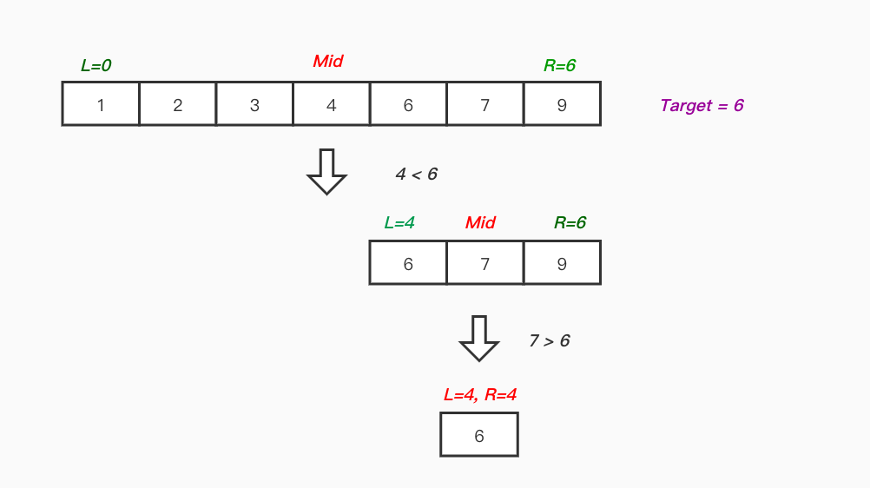
Machine learning vs. Regular Algorithm
Sorting Algorithms like bubble sort, Merge sort, Insertion sort
Search Algorithms like Linear Search, Binary Search

Slide 5
Machine Learning (Herbert Simon)
Learning is any process by which a system improves performance from experience.

Slide 6
Machine learning Algorithm
Machine Learning is an application of artificial intelligence where a computer/machine learns from the past experiences (input data) and makes future predictions. The performance of such a system should be at least human level.
Diverse Data Types
Prediction
Decision Making
Learning from Data

Slide 7
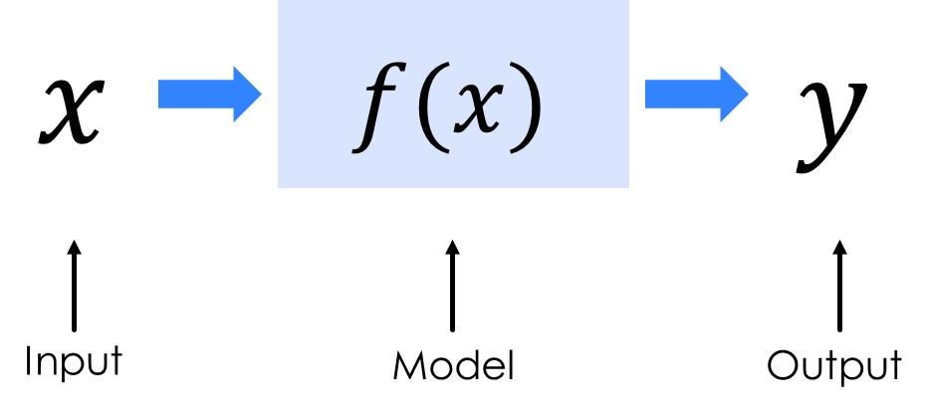
Machine Learning Categories
Machine Learning is generally categorized into three types:
  Supervised Learning,
  Unsupervised Learning,
  Reinforcement learning

Slide 8
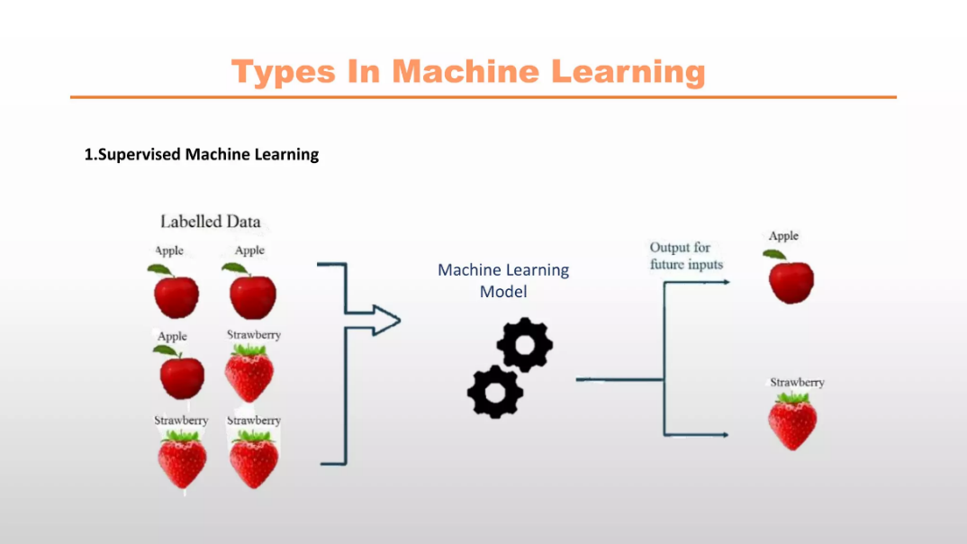
Supervised Learning:
Supervised Learning: The machine has a “teacher” who guides it by providing sample inputs along with the desired output. The machine then maps the inputs and the outputs. This is similar to how we teach very young children with picture books. According to Yann LeCun, all of the AI machines we have used this form of learning (from speech recognition to self-driving cars).
In supervised learning the machine experiences the examples along with the labels or targets for each example. The labels in the data help the algorithm to correlate the features.

Slide 9
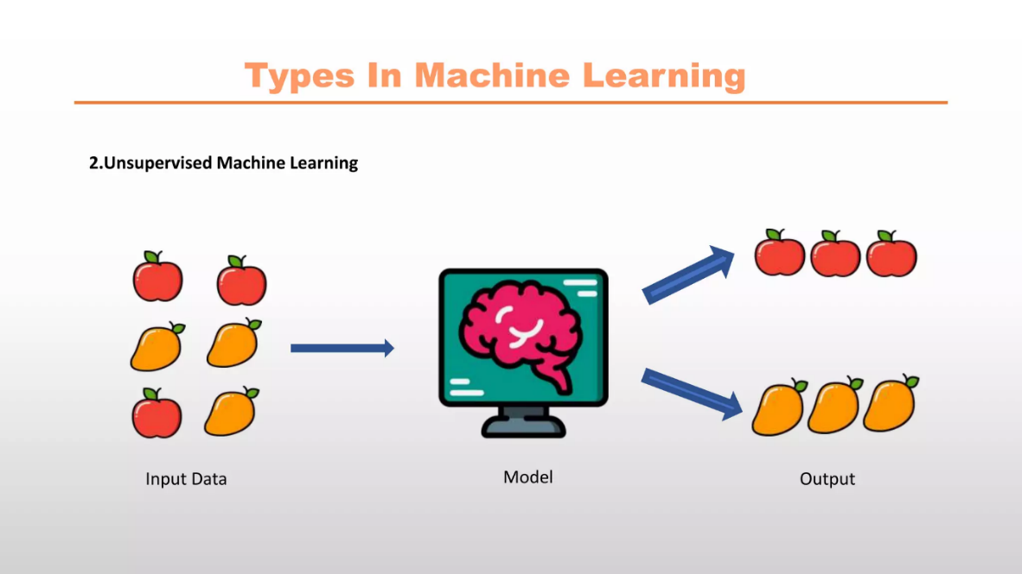
Unsupervised Learning:
Unsupervised Learning: This is the most important and most difficult type of learning and would be better titled Predictive Learning. In this case the machine is not given any labels for its inputs and needs to “figure out” the structure on its own. This is similar to how babies learn early in life. For example, they learn that if an object in space is not supported it will fall.
When we have unclassified and unlabeled data, the system attempts to uncover patterns from the data . There is no label or target given for the examples. One common task is to group similar examples together called clustering.

Slide 10
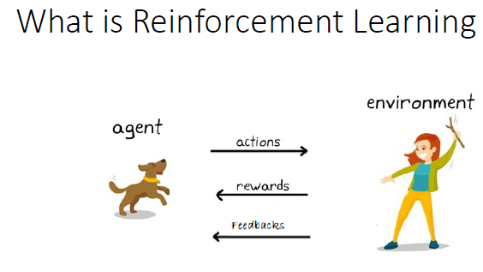
Reinforcement Learning:
Reinforcement learning refers to goal-oriented algorithms, which learn how to attain a complex objective (goal) or maximize along a particular dimension over many steps. This method allows machines and software agents to automatically determine the ideal behavior within a specific context in order to maximize its performance.
Yann LeCun believes this plays a relatively minor role in training AI and is similar to training an animal. When the animal displays a desired behavior it is given a reward.
According to the Wikipedia entry on Machine Learning, reinforcement learning is defined as “a computer program interacts with a dynamic environment in which it must perform a certain goal (such as driving a vehicle), without a teacher explicitly telling it whether it has come close to its goal. “

Slide 11
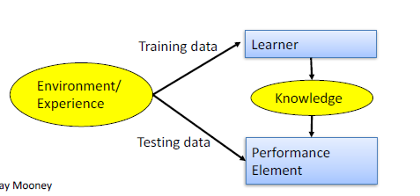
Designing a Learning System
• Choose the training experience
• Choose exactly what is to be learned i.e. the target function
• Choose how to represent the target function
• Choose a learning algorithm to infer the target function from the experience

Slide 12
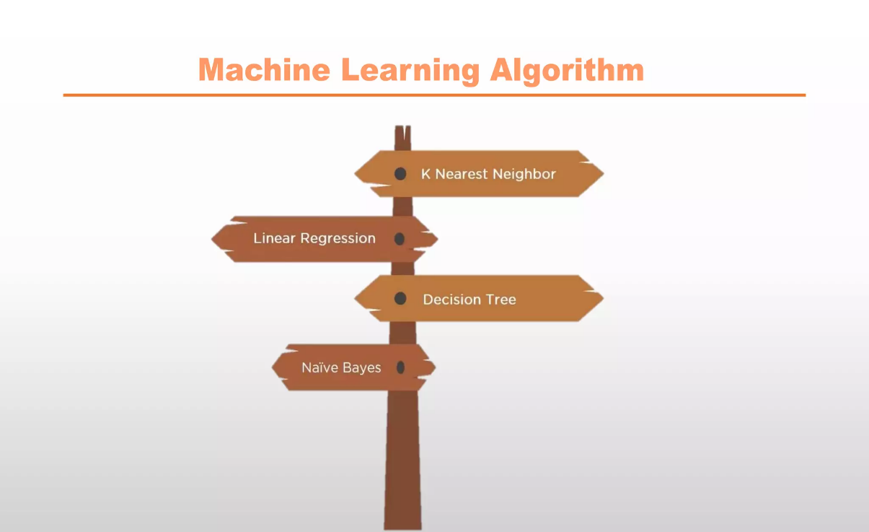
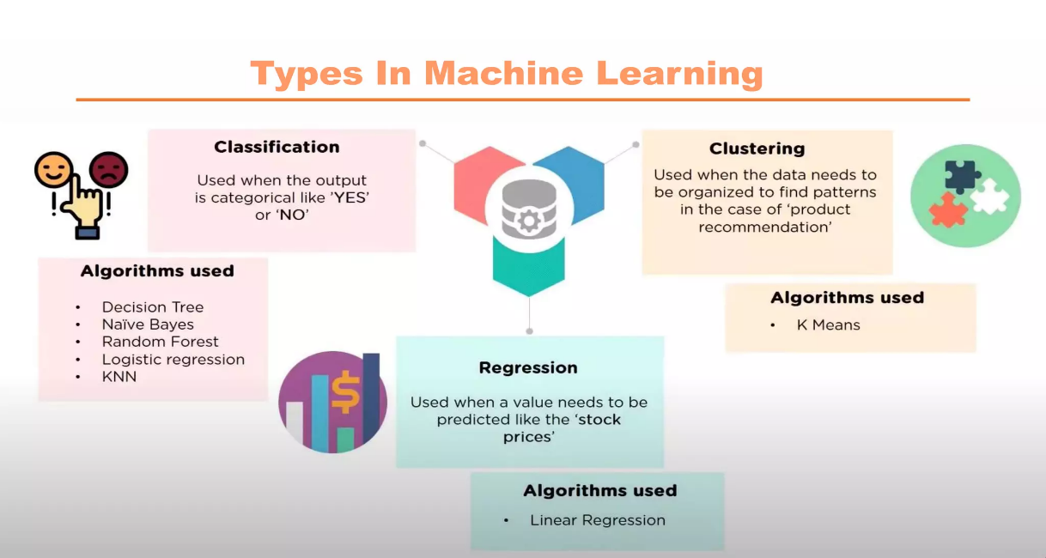
Various Function Representations
Numerical functions
– Linear regression
– Neural networks
– Support vector machines
Symbolic functions
– Decision trees
– Rules in propositional logic
– Rules in first-order predicate logic
- Instance-based functions
– Nearest-neighbor
Probabilistic Graphical Models
– Naïve Bayes
– Bayesian networks
– Hidden-Markov Models (HMMs)
– Markov network

Slide 13
Techniques of Supervised Machine Learning
Regression is a technique used to predict the value of a response (dependent) variables, from one or more predictor (independent) variables.
Most commonly used regressions techniques are: Linear Regression and Logistic Regression.

Slide 14
goal
Data Collection
Data Prediction
Data Visualization
Data Analysis

Slide 15
J48
J48 algorithm is one of the most widely used machine learning algorithms to examine the data categorically and continuously. The C4.5 algorithm (J48) is mostly used among many fields for classifying data for example interpreting the clinical data for the diagnosis of coronary heart disease, classifying E-governance data, and many more.
The machine learning process has two main phases:
  a learning phase, where the classification algorithm is trained, and
  a classification phase, where the algorithm labels new data. Classification is a data mining task that maps the data into predefined groups and classes, also known as supervised learning.
The term "lazy learning" or "lazy algorithm" is used to describe the k-Nearest Neighbors (KNN) algorithm because it doesn't actively learn a model during the training phase. Instead, it defers the learning process until the prediction or testing phase. This is in contrast to other machine learning algorithms, such as decision trees or neural networks, which build an explicit model during training that is then used for predictions.

Slide 16
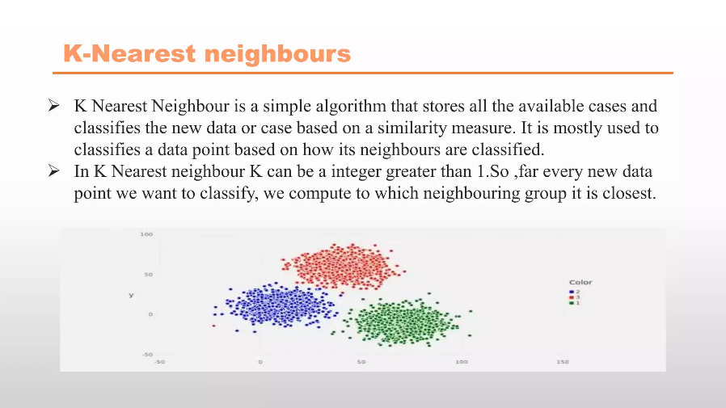

Slide 17
Training Sets, Test Sets, and 10-fold Cross-validation
We divided each of these datasets in turn into two subsets:
  One subset we used to construct the classifier. This data set is called the training set.
  The other set was used to evaluate the classifier. That data is called the test set. Training set and test set are common terms in data mining.

Slide 18
10-Fold Cross Validation
With this method we have one data set which we divide randomly into 10 parts. We use 9 of those parts for training and reserve one tenth for testing. We repeat this procedure 10 times each time reserving a different tenth for testing.

Slide 19
Example:
Suppose I want to build a classifier that just answers yes or no to the question Is this person a professional basketball player? My data consists of information about 500 basketball players and 500 non-basketball players.

Slide 20
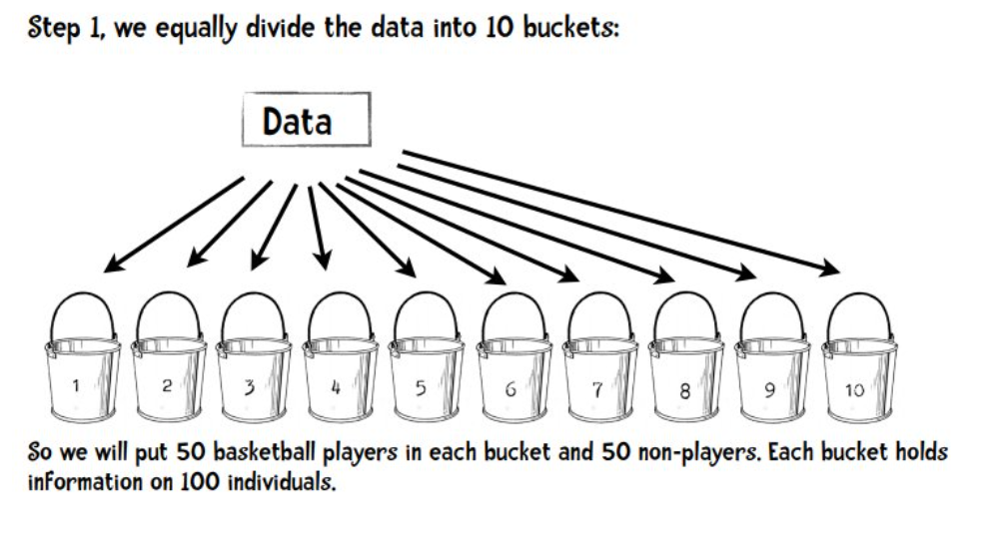

Slide 21
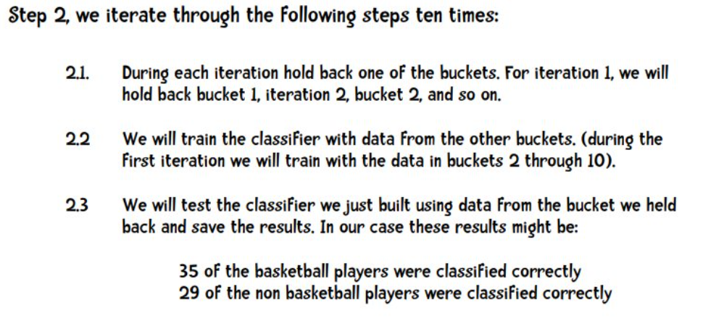


Slide 22
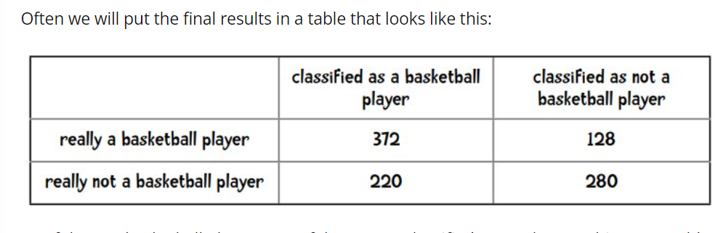
So of the 500 basketball players 372 of them were classified correctly. One thing we could do is add things up and say that of the 1,000 people we classified 652 (372 + 280) of them correctly. So our accuracy is 65.2%. The measures we obtain using ten-fold cross-validation are more likely to be truly representative of the classifiers performance compared with twofold, or three-fold cross-validation. This is so, because each time we train the classifier we are using 90% of our data compared with using only 50% for two-fold cross-validation.

Slide 23
Performance evaluation Measures
A confusion matrix provides an easy summary of the predictive results in a classification problem. Correct and incorrect predictions are summarized in a table with their values and broken down by each class.
From confusion matrix, we can also calculate the model’s accuracy, precision recall and F1 score. These measures help to understand the model’s performance. From the formulae, we can calculate these measures and for calculating we can use confusion matrix.

Slide 24
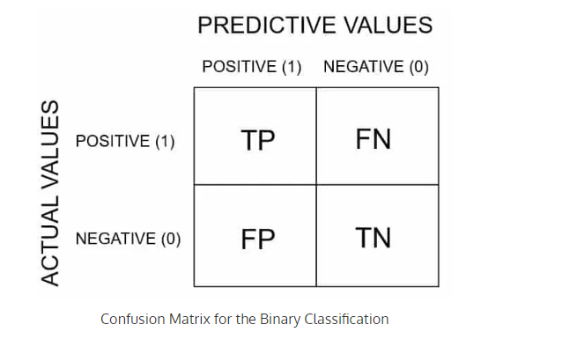
Confusion Matrix
A confusion matrix provides a easy summary of the predictive results in a classification problem. Correct and incorrect predictions are summarized in a table with their values and broken down by each class.

Slide 25
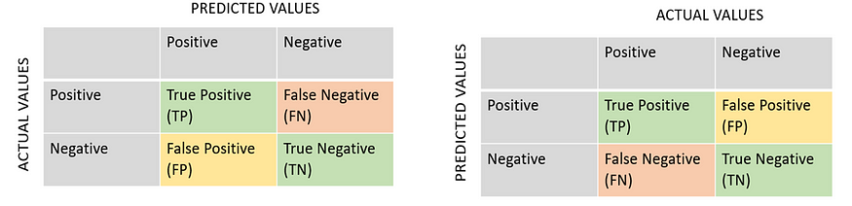
Definition of the Terms:
True Positive: You predicted positive and it’s true. You predicted that an animal is a cat, and it actually is.
True Negative: You predicted negative and it’s true. You predicted that animal is not a cat and it actually is not (it’s a dog).
False Positive: You predicted positive and it’s false. You predicted that animal is a cat but it actually is not (it’s a dog).
False Negative: You predicted negative and it’s false. You predicted that animal is not a cat but it actually is.

Slide 26
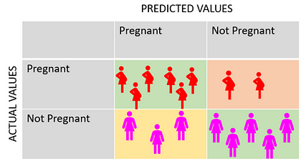
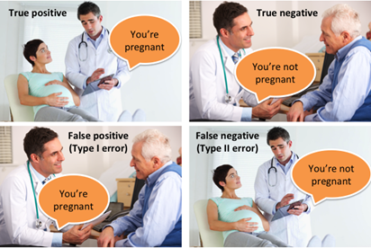
Simple examples to better understand the concept
there are two classes of pregnant/not pregnant are two classes.
There are 8 women pregnant and 8 women not pregnant, the model classified 6 pregnant (true positive) and 5 not pregnant (true negative) women correctly, but 3 not pregnant (false positive) women as pregnant and 2 pregnant (false negative) women as not pregnant.

Slide 27
Accuracy: Accuracy is the ratio of the records that the model correctly classified over the total number of records. For example, if there are 10 red balls and 10 purple balls, 8 red and 7 purple balls you identified correctly, then your accuracy is 8+7/20=0.75 and hence, accuracy is 75%..
Precision: Precision is the ratio of the positives that are correctly identified by the model over total positive records. For example, if there are 10 red balls and 10 purple balls, one has to identify which are red balls and for any reason you recognized 8 red balls and 2 purple balls as “red balls” then your precision is 8/10, i.e., 80%.
Sensitivity: the ability of a test to correctly identify true positives (people who have the disease and model identified it so).
Specificity: the ability of a test to correctly identify true negatives (people who don’t have the disease and model identified it so).
F1 score: The F1 score is a weighted average of the precision and recall/sensitivity, with a best score at 1 and worst score at 0. The formula is as below.

Slide 28
Classification Accuracy:
Classification Accuracy is given by the relation:
Accuracy is the ratio of the records that the model correctly classified over the total number of records.
Recall (aka Sensitivity):
Recall is defined as the ratio of the total number of correctly classified positive classes divide by the total number of positive classes. Or, out of all the positive classes, how much we have predicted correctly. Recall should be high.

Slide 29
Precision:
Precision is defined as the ratio of the total number of correctly classified positive classes divided by the total number of predicted positive classes. Or, out of all the predictive positive classes, how much we predicted correctly. Precision should be high.
F-score or F1 score:
It is difficult to compare two models with different Precision and Recall. So to make them comparable, we use F-Score. It is the Harmonic Mean of Precision and Recall. As compared to Arithmetic Mean, Harmonic Mean punishes the extreme values more. F-score should be high.

Slide 30
Specificity:
Specificity determines the proportion of actual negatives that are correctly identified.

Slide 31
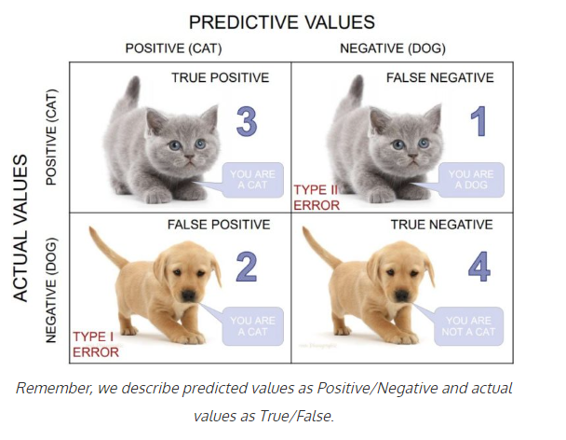
Calculate a confusion matrix: Example II
Let’s take an example:
We have a total of 10 cats and dogs and our model predicts whether it is a cat or not.
Actual values = [‘dog’, ‘cat’, ‘dog’, ‘cat’, ‘dog’, ‘dog’, ‘cat’, ‘dog’, ‘cat’, ‘dog’]
Predicted values = [‘dog’, ‘dog’, ‘dog’, ‘cat’, ‘dog’, ‘dog’, ‘cat’, ‘cat’, ‘cat’, ‘cat’]

Slide 32
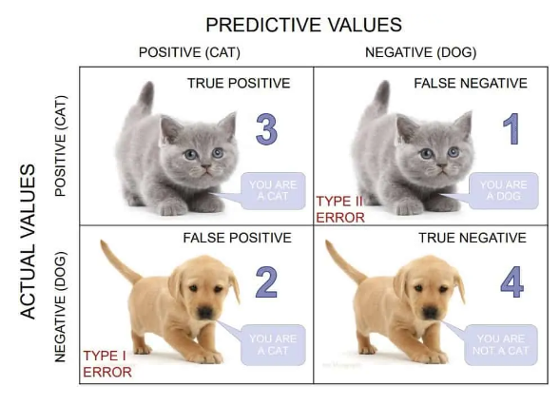
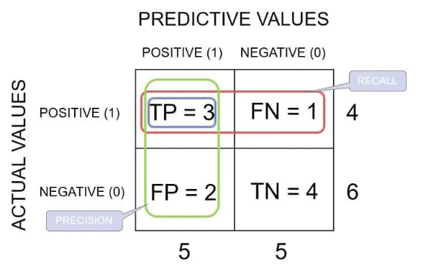
Example
Classification Accuracy:
Accuracy = (TP + TN) / (TP + TN + FP + FN) = (3+4)/(3+4+2+1) = 0.70
Recall: Recall gives us an idea about when it’s actually yes, how often does it predict yes.
Recall = TP / (TP + FN) = 3/(3+1) = 0.75
Precision: Precision tells us about when it predicts yes, how often is it correct.
Precision = TP / (TP + FP) = 3/(3+2) = 0.60.
F-score:
F-score = (2*Recall*Precision)/(Recall+Precision) = (2*0.75*0.60)/(0.75+0.60) = 0.67
Specificity:
Specificity = TN / (TN + FP) = 4/(4+2) = 0.6

Slide 33
In python
# Python script for confusion matrix creation.
from sklearn.metrics import confusion_matrix
from sklearn.metrics import accuracy_score
from sklearn.metrics import classification_report
actual = ['dog','cat', 'dog', 'cat', 'dog', 'dog', 'cat', 'dog', 'dog', 'cat’]
predicted = ['dog', 'dog', 'dog', 'cat', 'dog', 'dog', 'cat', 'cat', 'cat', 'cat’]
results = confusion_matrix(actual, predicted)
print ('Confusion Matrix :’)
print(results)
print ('Accuracy Score :',accuracy_score(actual, predicted))
print('Classification Report : ‘)
print (classification_report(actual, predicted))

Slide 34
What is Linear Regression?
Linear regression is a type of statistical analysis used to predict the relationship between two variables. It assumes a linear relationship between the independent variable and the dependent variable, and aims to find the best-fitting line that describes the relationship. The line is determined by minimizing the sum of the squared differences between the predicted values and the actual values.

Slide 35
Simple Linear Regression
In a simple linear regression, there is one independent variable and one dependent variable. The model estimates the slope and intercept of the line of best fit, which represents the relationship between the variables.
The slope represents the change in the dependent variable for each unit change in the independent variable, while the intercept represents the predicted value of the dependent variable when the independent variable is zero.

Slide 36
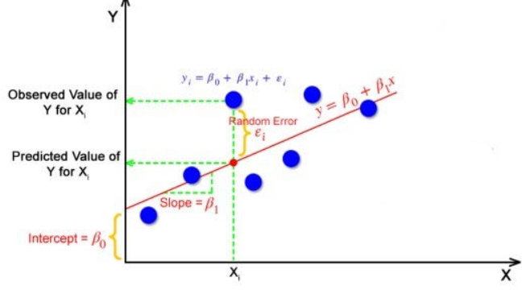
Linear Regression
features
Dependent variable
Intercept with y-axis
slope
independent variable

Slide 37
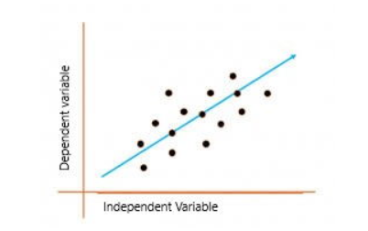
Linear regression is a quiet and the simplest statistical regression method used for predictive analysis in machine learning. Linear regression shows the linear relationship between the independent(predictor) variable i.e. X-axis and the dependent(output) variable i.e. Y-axis, called linear regression. If there is a single input variable X(independent variable), such linear regression is called simple linear regression.

Slide 38
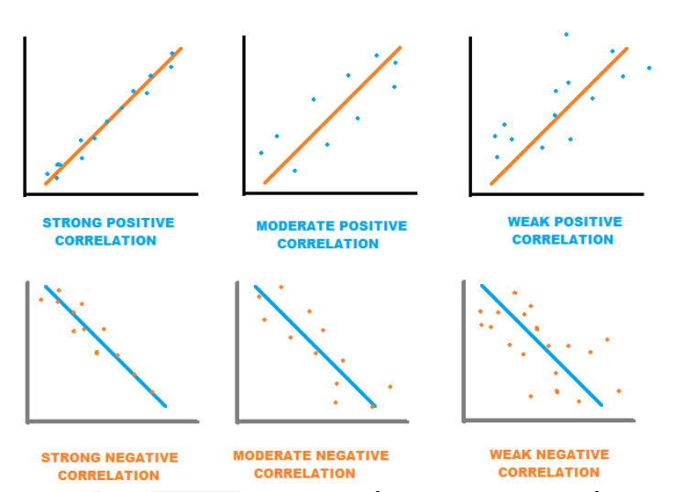
If when one of the variable increases the other also increases or one decreases the other also decreases, we say they are moving in the same direction and hence the correlation is positive.
If the data points are close to the best fit line, we say there is a strong correlation and if they are away and spread apart, we say the correlation is weak.

Slide 39
If when one variable increases, the other decreases or vice versa, we say they are moving in opposite directions and hence the correlation is negative.

Slide 40
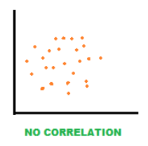
No correlation

Slide 41
Random Error(Residuals)
In regression, the difference between the observed value of the dependent variable(y_{i}) and the predicted value(predicted) is called the residuals.
ε_{i} = y_{predicted} – y_{i}
where y_{predicted} = B₀ + B₁ X_{i}

Slide 42
Model Evaluation
Statistical Measurement error

Slide 43

Cost Function for Linear Regression
The cost function/loss function helps to work out the optimal values for B₀ and B₁, which provides the best fit line for the data points.
In Linear Regression, generally Mean Squared Error (MSE) cost function is used, which is the average of squared error that occurred between the y_{predicted} and y_{i}.
We calculate MSE using simple linear equation y=mx+b:
Using the MSE function, we’ll update the values of B₀ and B₁ such that the MSE value settles at the minima. These parameters can be determined using the gradient descent method such that the value for the cost function is minimum.

Slide 44
Multiple R
This is the Pearson correlation coefficient that describes the correlation between the predicted values of Y and the observed values of Y. A value of 1 means that there is a perfect correlation between the two, and a value of 0 means that there is no correlation at all. In this analysis the value is 0.96, so there is a very strong correlation between the predicted and observed y-values.

Slide 45
R-Square:
This is the coefficient of determination and it explains how much of the variation in the dependent variable can be explained by the equation. In this case, the R-Squared value is 0.91, so 91% of the variation is captured by the equation. That means the other 9% of the variation is not explained by the equation. It may be due to randomness or measurement error

Slide 46
Forecast error = actual -forecast

Slide 47
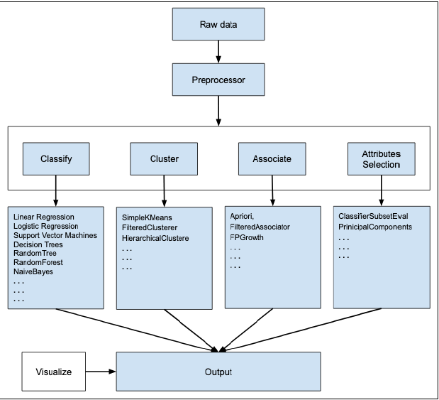

Slide 48
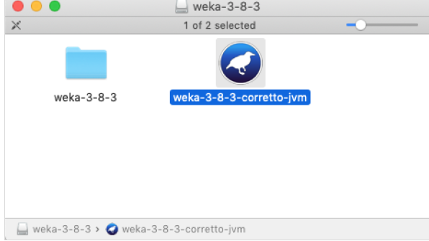
WEKA — Installation
To install WEKA on your machine, visit WEKA’s official website and download the installation file. WEKA supports installation on Windows, Mac OS X and Linux. You just need to follow the instructions on this page to install WEKA for your OS.
The steps for installing on Mac are as follows:
• Download the Mac installation file.
• Double click on the downloaded weka-3-8-3-corretto-jvm.dmg file.
You will see the following screen on successful installation.

Slide 49

The GUI Chooser application allows you to run five different types of applications as listed here:
Explorer
Experimenter
KnowledgeFlow
Workbench
Simple CLI
We will be using Explorer in this tutorial.

Slide 50
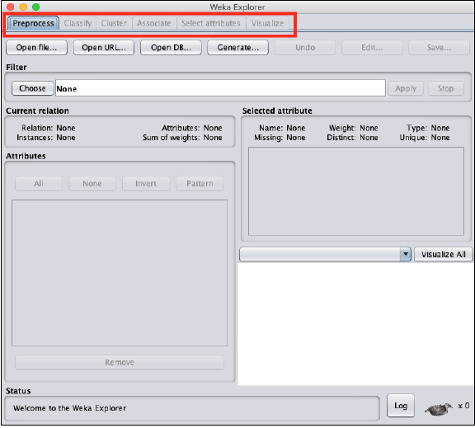
WEKA — Launching Explorer
In this chapter, let us look into various functionalities that the explorer provides for working with big data.
When you click on the Explorer button in the Applications selector, it opens the following screen:
On the top, you will see several tabs as listed here:
Preprocess
Classify
Cluster
Associate
Select Attributes
Visualize

Slide 51
Preprocess Tab
Initially as you open the explorer, only the Preprocess tab is enabled. The first step in machine learning is to preprocess the data. Thus, in the Preprocess option, you will select the data file, process it and make it fit for applying the various machine learning algorithms.
Classify Tab
The Classify tab provides you several machine learning algorithms for the classification of your data. To list a few, you may apply algorithms such as Linear Regression, Logistic Regression, Support Vector Machines, Decision Trees, RandomTree, RandomForest, NaiveBayes, and so on. The list is very exhaustive and provides both supervised and unsupervised machine learning algorithms.
Cluster Tab
Under the Cluster tab, there are several clustering algorithms provided - such as SimpleKMeans, FilteredClusterer, HierarchicalClusterer, and so on.
Associate Tab
Under the Associate tab, you would find Apriori, FilteredAssociator and FPGrowth.
Select Attributes Tab
Select Attributes allows you feature selections based on several algorithms such as ClassifierSubsetEval, PrinicipalComponents, etc.
Visualize Tab
Lastly, the Visualize option allows you to visualize your processed data for analysis.
As you noticed, WEKA provides several ready-to-use algorithms for testing and building your machine learning applications. To use WEKA effectively, you must have a sound knowledge of these algorithms, how they work, which one to choose under what circumstances, what to look for in their processed output, and so on. In short, you must have a solid foundation in machine learning to use WEKA effectively in building your apps.

Slide 52
Loading Data from Local File System
Just under the Machine Learning tabs that you studied in the previous lesson, you would find the following three buttons:
Open file …
Open URL …
Open DB …

Slide 53
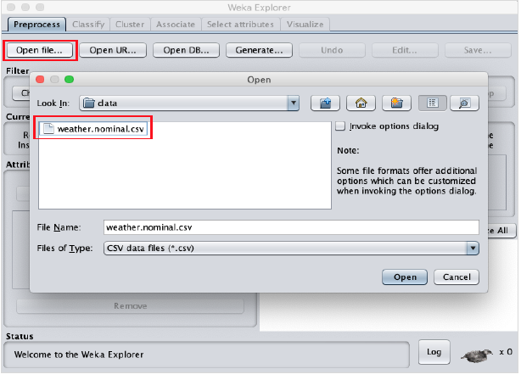
Click on the Open file ... button. A directory navigator window opens as shown in the following screen:

Slide 54
WEKA — File Formats
WEKA supports a large number of file formats for the data. Here is the complete list:
arff
arff.gz
bsi
csv
dat
data
json
json.gz
libsvm
m
names
xrff
xrff.gz

Slide 55
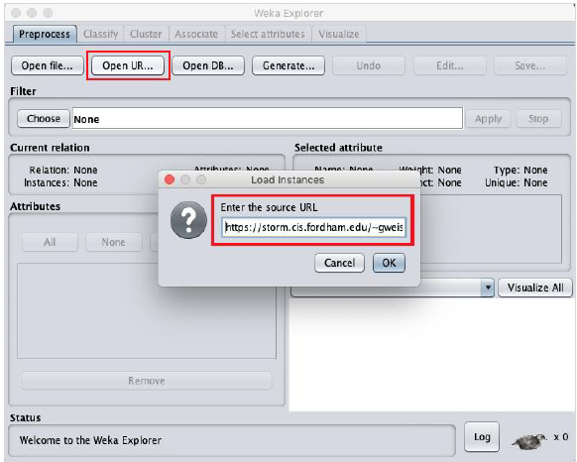
Loading Data from Web
Once you click on the Open URL … button, you can see a window as follows:
We will open the file from a public URL Type the following URL in the popup box:
https://storm.cis.fordham.edu/~gweiss/data-mining/weka-data/weather.nominal.arff
You may specify any other URL where your data is stored. The Explorer will load the data from the remote site into its environment.

Slide 56
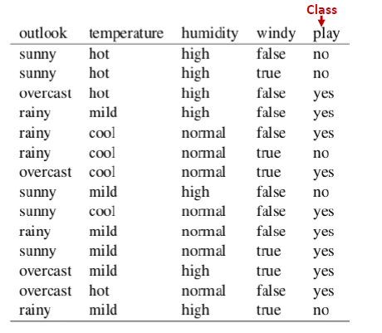
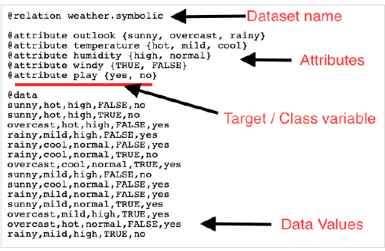
As an example for Arff format, the Weather data file loaded from the WEKA sample databases is shown below: https://storm.cis.fordham.edu/~gweiss/data-mining/weka-data/weather.nominal.arff

Slide 57
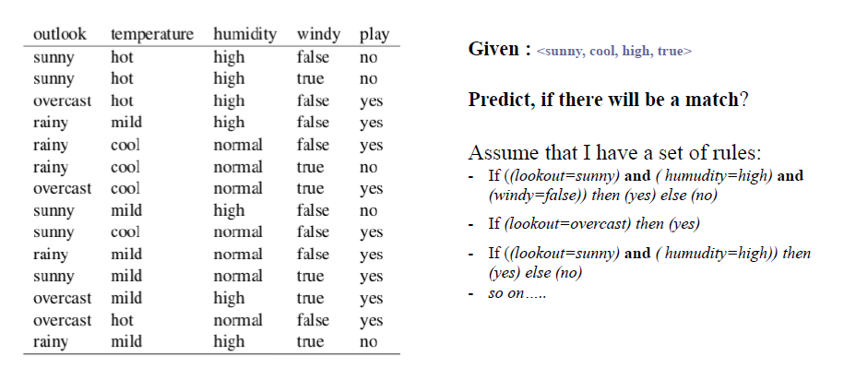
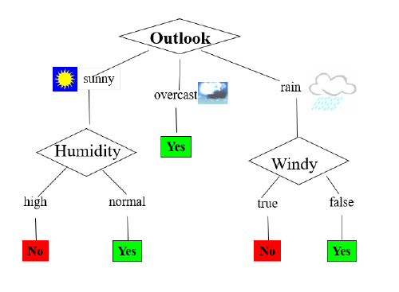
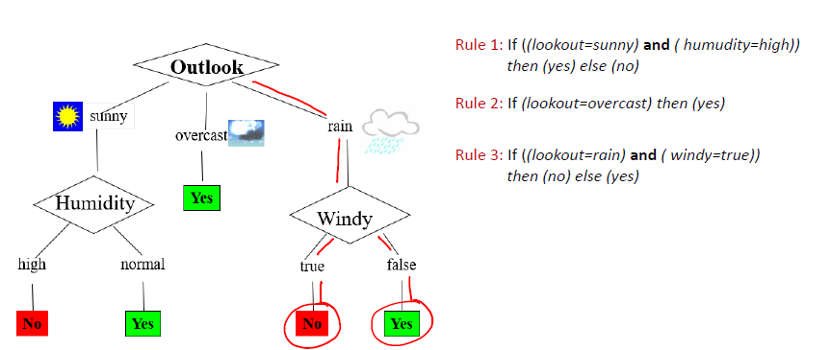
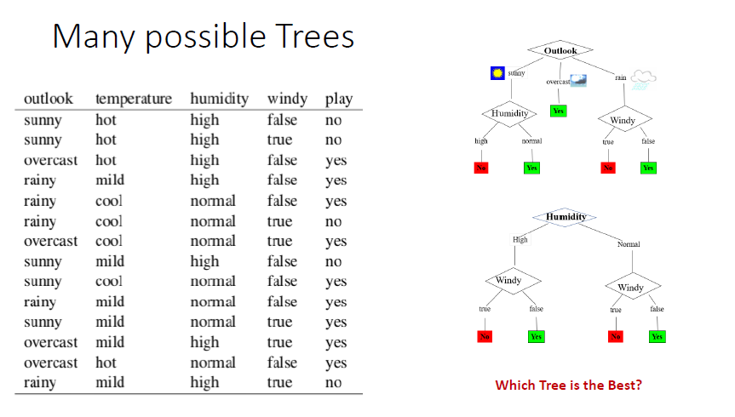

Slide 58
From the screenshot, you can infer the following points:
The @relation tag defines the name of the database.
The @attribute tag defines the attributes.
The @data tag starts the list of data rows each containing the comma separated fields.
The attributes can take nominal values as in the case of outlook shown here:
@attribute outlook (sunny, overcast, rainy)
The attributes can take real values as in this case:
@attribute temperature real
You can also set a Target or a Class variable called play as shown here:
@attribute play (yes, no)
The Target assumes two nominal values yes or no.

Slide 59
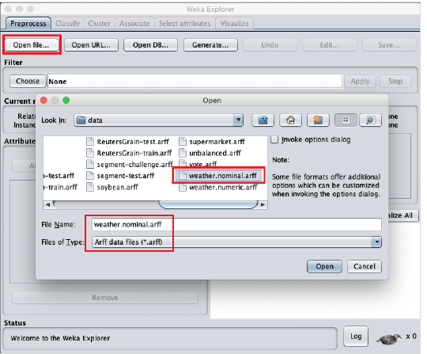
WEKA — Preprocessing the Data
Using the Open file ... option under the Preprocess tag select the weather-nominal.arff file.

Slide 60
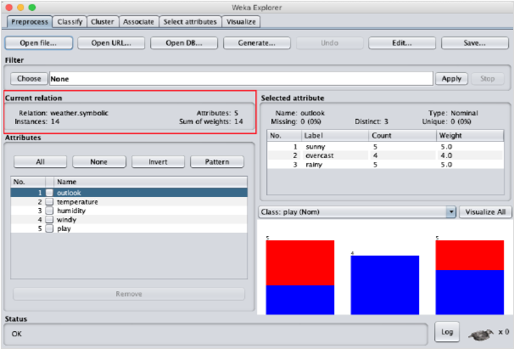
When you open the file, your screen looks like as shown here:

Slide 61
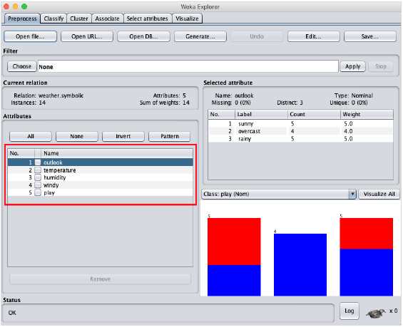
Understanding Data
Let us first look at the highlighted Current relation sub window. It shows the name of the database that is currently loaded. You can infer two points from this sub window:
There are 14 instances - the number of rows in the table.
The table contains 5 attributes - the fields, which are discussed in the upcoming sections.
On the left side, notice the Attributes sub window that displays the various fields in the database.
The weather database contains five fields - outlook, temperature, humidity, windy and play. When you select an attribute from this list by clicking on it, further details on the attribute itself are displayed on the right hand side.

Slide 62
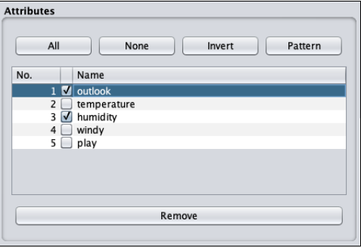
Removing Attributes
Many a time, the data that you want to use for model building comes with many irrelevant fields. For example, the customer database may contain his mobile number which is relevant in analysing his credit rating.
To remove Attribute/s select them and click on the Remove button at the bottom.
The selected attributes would be removed from the database. After you fully preprocess the data, you can save it for model building.
Next, you will learn to preprocess the data by applying filters on this data.

Slide 63
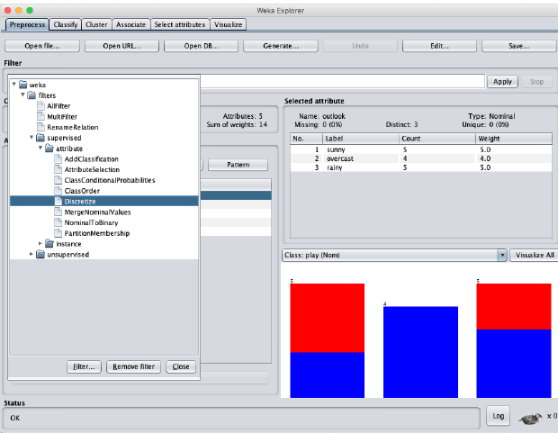
Applying Filters
Some of the machine learning techniques such as association rule mining requires categorical data. To illustrate the use of filters, we will use weather-numeric.arff database that contains two numeric attributes - temperature and humidity.
We will convert these to nominal by applying a filter on our raw data. Click on the Choose button in the Filter subwindow and select the following filter:
weka->filters->supervised->attribute->Discretize
Click on the Apply button and examine the temperature and/or humidity attribute. You will notice that these have changed from numeric to nominal types.

Slide 64
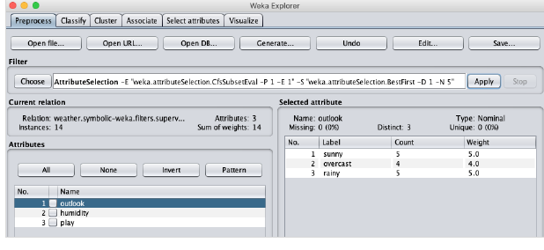
Let us look into another filter now. Suppose you want to select the best attributes for deciding the play. Select and apply the following filter:
weka->filters->supervised->attribute->AttributeSelection
You will notice that it removes the temperature and humidity attributes from the database.
After you are satisfied with the preprocessing of your data, save the data by clicking the Save … button. You will use this saved file for model building.
In the next chapter, we will explore the model building using several predefined ML algorithms.

Slide 65
WEKA — Classifiers
Many machine learning applications are classification related. For example, you may like to classify a tumor as malignant or benign. You may like to decide whether to play an outside game depending on the weather conditions. Generally, this decision is dependent on several features/conditions of the weather. So you may prefer to use a tree classifier to make your decision of whether to play or not.
In this chapter, we will learn how to build such a tree classifier on weather data to decide on the playing conditions.

Slide 66
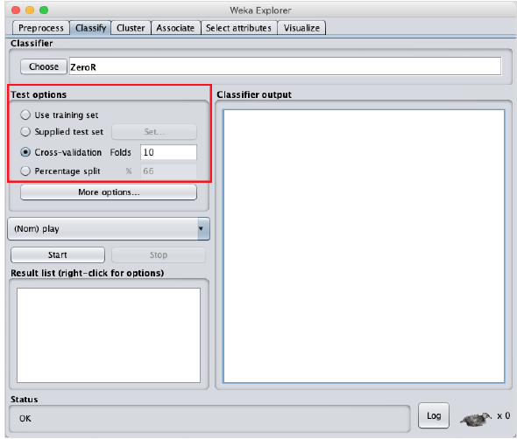
Setting Test Data
We will use the preprocessed weather data file from the previous lesson. Open the saved file by using the Open file ... option under the Preprocess tab, click on the Classify tab, and you would see the following screen:
Before you learn about the available classifiers, let us examine the Test options. You will notice four testing options as listed below:
Training set
Supplied test set
Cross-validation
Percentage split

Slide 67
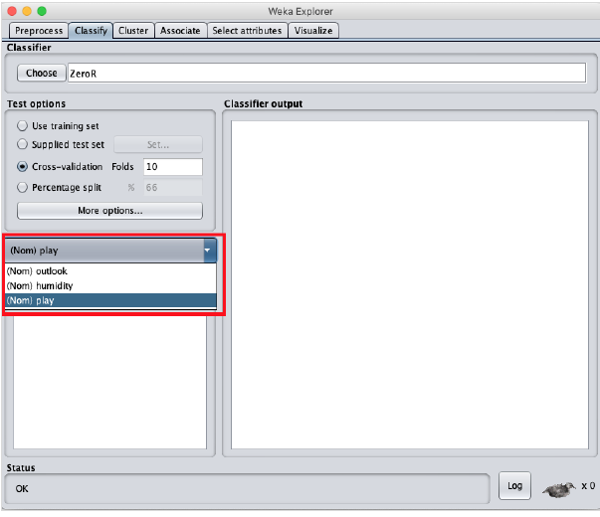
Unless you have your own training set or a client supplied test set, you would use cross-validation or percentage split options. Under cross-validation, you can set the number of folds in which entire data would be split and used during each iteration of training. In the percentage split, you will split the data between training and testing using the set split percentage.
Now, keep the default play option for the output class:

Slide 68
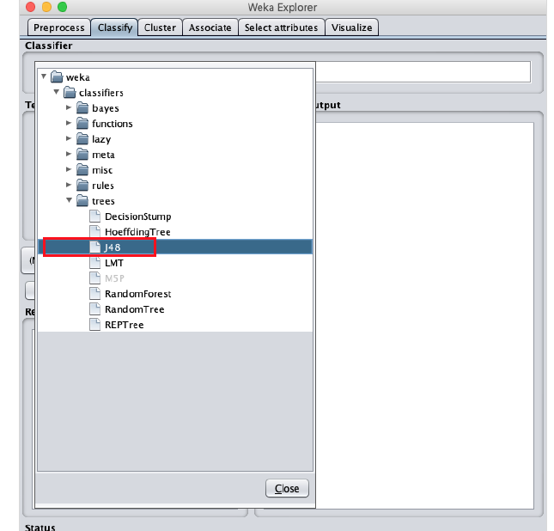
Next, you will select the classifier.
Click on the Choose button and select the following classifier: weka->classifiers>trees>J48
This is shown in the screenshot below:

Slide 69
Click on the Start button to start the classification process. After a while, the classification results would be presented on your screen as shown here:

Slide 70
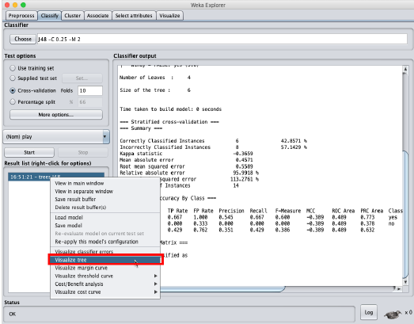
Visualize Results
To see the visual representation of the results, right click on the result in the Result list box. Several options would pop up on the screen as shown here:

Slide 71
Select Visualize tree to get a visual representation of the traversal tree as seen in the screenshot below:

Slide 72
Selecting Visualize classifier errors would plot the results of classification as shown here:
A cross represents a correctly classified instance while squares represents incorrectly classified instances. At the lower left corner of the plot you see a cross that indicates if outlook is sunny then play the game. So this is a correctly classified instance. To locate instances, you can introduce some jitter in it by sliding the jitter slide bar.

Slide 73
The current plot is outlook versus play. These are indicated by the two drop down list boxes at the top of the screen.

Slide 74
Now, try a different selection in each of these boxes and notice how the X & Y axes change. The same can be achieved by using the horizontal strips on the right hand side of the plot. Each strip represents an attribute. Left click on the strip sets the selected attribute on the X-axis while a right click would set it on the Y-axis.

Slide 75
Knowledge flow

Slide 76
Loading the data

Slide 77
Removing attributes

Slide 78
Visualize data

Slide 79
Connect the flow

Slide 80
Start data flow

Slide 81
Visualize the data

Slide 82
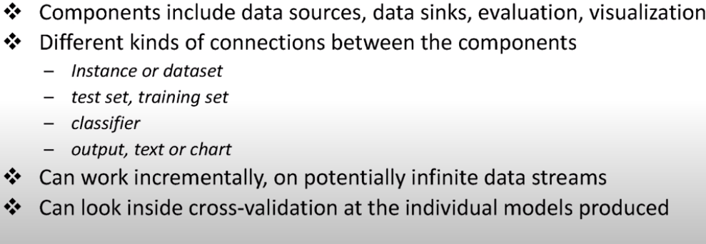

Slide 83
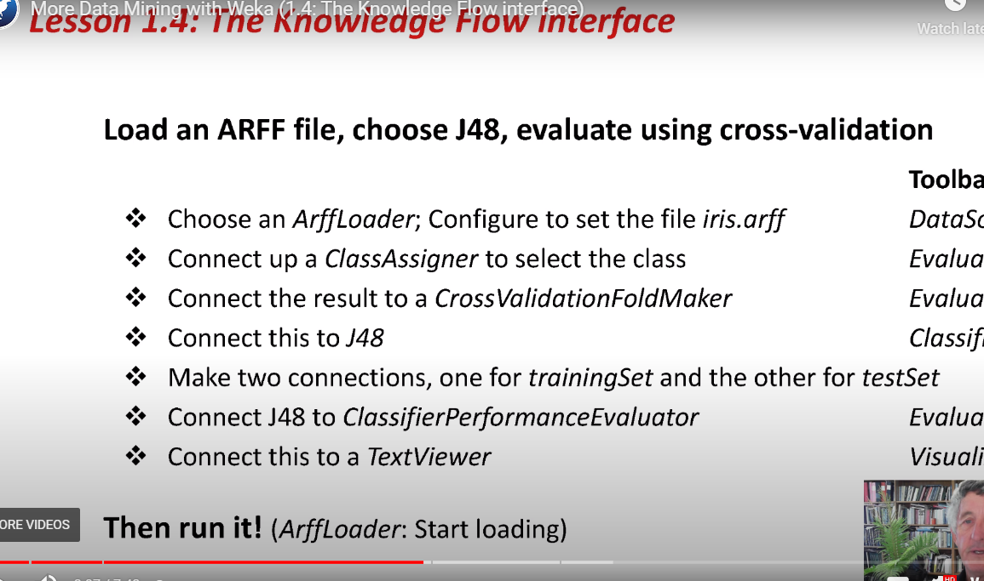

Slide 84

Short video: Explorer

Slide 85

Short video : KnowledgeFlow

Slide 86
Name: | Email address:
Title
Description
Data source
ML -Model
Evaluation Tools
Discuss and recommendation
References

Slide 87
Thank You for Your Attention

