Slide 1
9:45 - 11:15 Uhr
Artificial intelligence in applications. Modeling, Machine Learning and Data Classifier Performance Prof. Dr. Galia Weidl Rechnerraum - Labor 26-318 WF_WiSe Galia.weidl@th-ab.de

Slide 2
Scheduling
Monday, 16/10/2023- Dr. Jamal Raiyn, Artificial Intelligence
Monday, 23/10/2023- Dr. Jamal Raiyn, Machine Learning based WEKA
Monday, 30/10/2023 – Monday, 27/11/2023 – Prof. Dr. Galia Weidl – Basics on Data sources, data preprocessing, Techniques and Tools for learning in Applications of OOBN
  Monday, 30/10/2023 – Mofeed Chaar – data processing with python
  Monday, 6/11/2023 – Kranthi Talluri – case study on traffic congestion – from data to application results: recognition of congestion
  Distribution of Students’ Presentations
Monday, 4, 11, 18/12/2023 – Students’ presentations of selected applications
Monday, 8, 15/01/2024 – Students’ presentations of selected applications
Exams: 19-25/01/2024 (19/01/2024 – first day of exams)

Slide 3
Artifial Intelligence and its Application
Dr. Jamal Raiyn
Jamal.raiyn@th-ab.de

Slide 4
Contents
Introduction
AI Definition and Goals
AI Characteristics
Knowledge Representation
Reasoning with uncertainty
Machine Learning and Data Mining
Application of AI

Slide 5
What is Artificial Intelligence (AI)
What is intelligence?
How can intelligence be measured?
How does our brain work?
Intelligence machine?

Slide 6
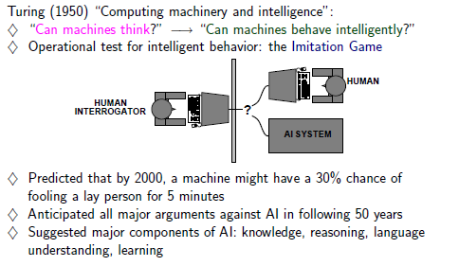
Acting humanly: Turing Test
The Turing Test was proposed by British mathematician and computer scientist Alan Turing in 1950. The test is typically applied to assess a computer's ability to engage in natural language conversation. The test involves a human judge who engages in natural language conversations with both a machine and a human, without knowing which is which. If the judge cannot reliably distinguish which one is the machine based on the conversation, the machine is said to have passed the Turing Test, demonstrating a high level of conversational artificial intelligence.

Slide 7
John McCarthy-1955
The aim of AI is to develop machines that behaves as if they were intelligence

Slide 8
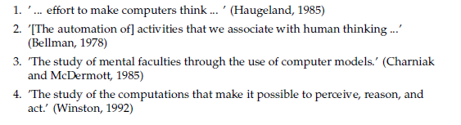
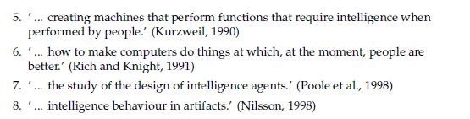
There is no world wide definition for AI

Slide 9
Franklin and Graesser-1997
define an autonomous agent that senses their environment
and acts on it.

Slide 10
Wooldrige and Jennings 1995
reactive agents that perceive their environment and response in a timely fashion to changes that occur in the environment, in other words,
whose behavior is determined as a result of
a reasoning process based on
beliefs and desires.

Slide 11
Russell and Norvig first edition: 1995 fourth edition: 2020
an agent is something that perceive and act rational to achieve his goal based on both
its own experience and the built-in
knowledge used in constructing
the agent for the particular
environment in which
it operates.

Slide 12


Summary
Systems that think like humans
Systems that act like humans
Systems that think rationally
Systems that act rationally
Driverless car/ autonomous car
Based Logic

Slide 13
Human Intelligence
Definition: ???
Measure : IQ test

Slide 14
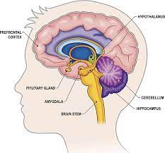
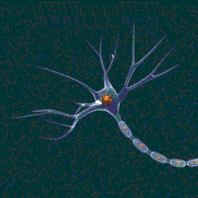
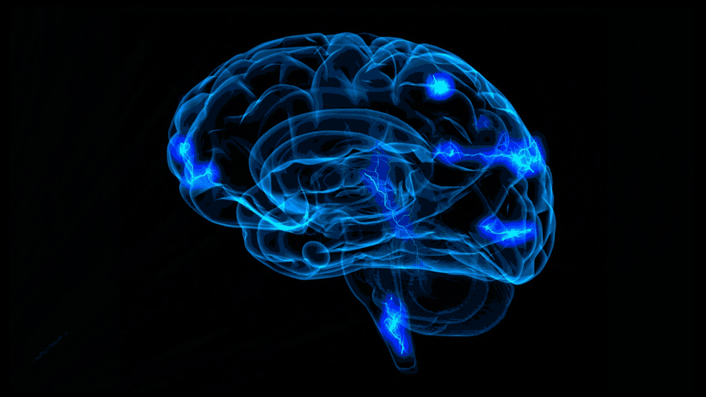

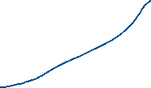
the life story of a Canadian patient formerly know as H.M. which now and after his death we know them to be initials for Henry Molaison.
H.M. had a condition called epilepsy, which caused him to have sudden and uncontrolled seizures. Doctors removed a part of his brain to stop the seizures, including the part that helps us remember things. After the surgery, he couldn't make new memories, so he was stuck in the past. This helped scientists learn how the brain handles memory.
feeling

Slide 15
Computational Intelligence
The expression computational intelligence usually refers to the ability of a computer to learn a specific task from data or experimental observation. Even though it is commonly considered a synonym of soft computing, there is still no commonly accepted definition of computational intelligence.

Slide 16
Pool from the university of British Columbia
A definition found on a science website says it is the study of the design of “intelligent agents.”
an agent is “ something that acts in an environment.” Agents act to achieve a goal. The intelligent agent learns and adapts.

Slide 17
According to Bezdek (1994),
Computational Intelligence is a subset of Artificial Intelligence. There are two types of machine intelligence: the artificial one based on hard computing techniques and the computational one based on soft computing methods, which enable adaptation to many situations.

Slide 18
What is the Difference Between AI and CI?
The two terms are basically the same. The primary goal of each is to understand what makes intelligence possible. That study covers intelligence in nature and in artificial systems.
Instead of the term “artificial,” many scientists prefer synthetic.
The reason is in the inferences made from the terms. “Artificial” denotes something that is not real. “Synthetic” means something that is synthesized but still real in the way that a synthetic pearl is still a pearl, although it is not natural.
Poole, Mackworth and Goebel:
Instead of the term “artificial,” prefer computational Intelligence

Slide 19
Attributes of Intelligent Agent
Autonomy
Negotiation
Reasoning
Learning
Update
Mobile

Slide 20
Challenges of AI
Big data processing
Data anomalies detection

Slide 21
Big Data
Volume: collecting data from a variety of sources.
Velocity: Data streams in at an unprecedented speed and must be dealt with in a timely manner.
Variety: Data comes in all types of formats – from structured, numeric data in traditional databases to unstructured text documents, email, video, audio, stock ticker data and financial transactions.
Variability: In addition to the increasing velocities and varieties of data, data flows can be highly inconsistent with periodic peaks.

Slide 22
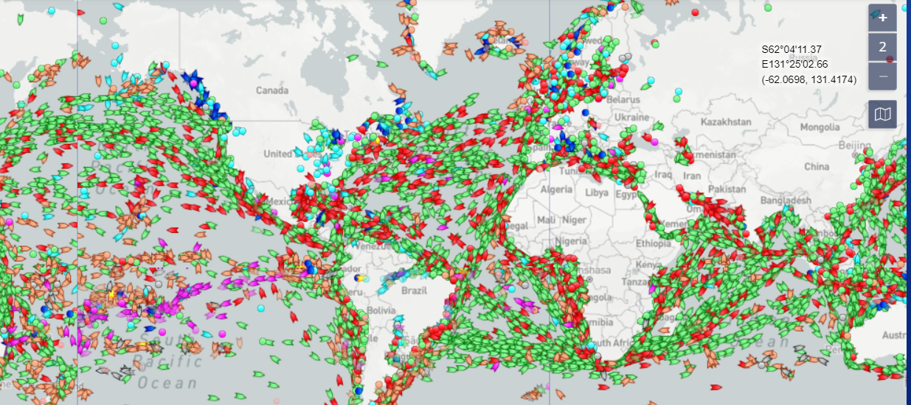
Marine Traffic
Maritime transportation is the lifeblood of the global economy; it accounts for the transport of 90% of the world’s trade goods.

Slide 23
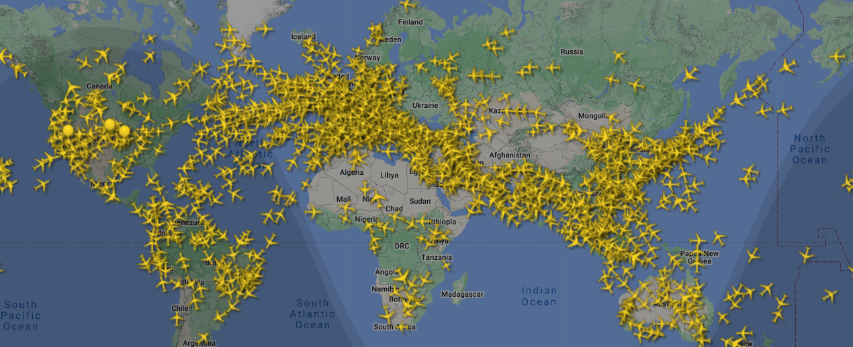
Air plan traffic
https://www.flightradar24.com/45.51,47.46/3

Slide 24
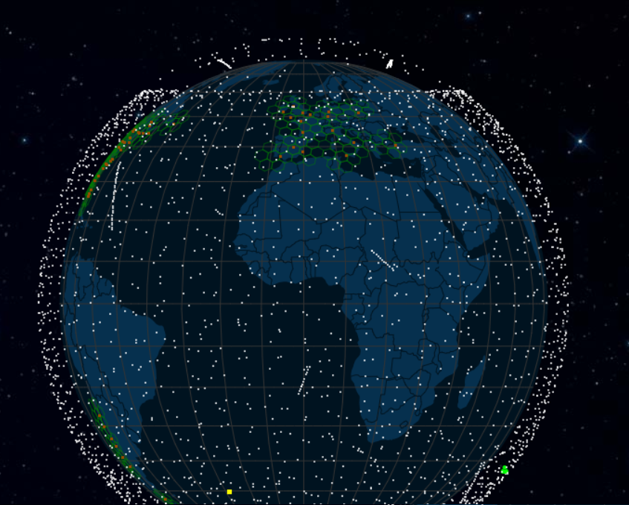
Satellite map
https://satellitemap.space/?constellation=starlink

Slide 25
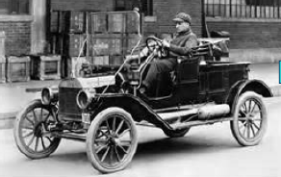
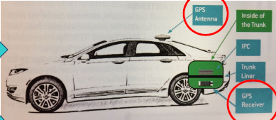
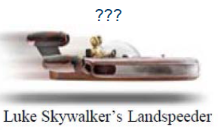
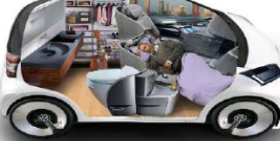
it will definitively need AI…
yesterday
Today car
Future car

Slide 26
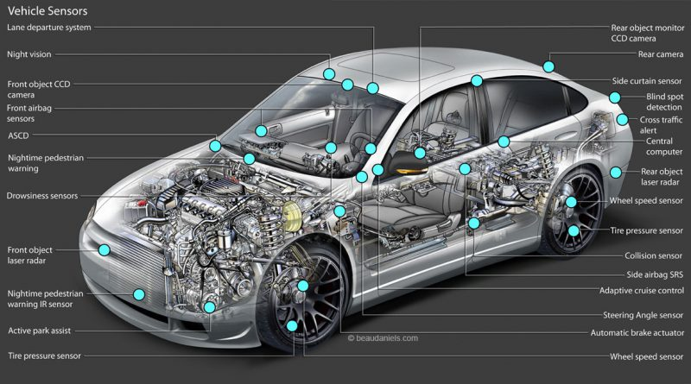
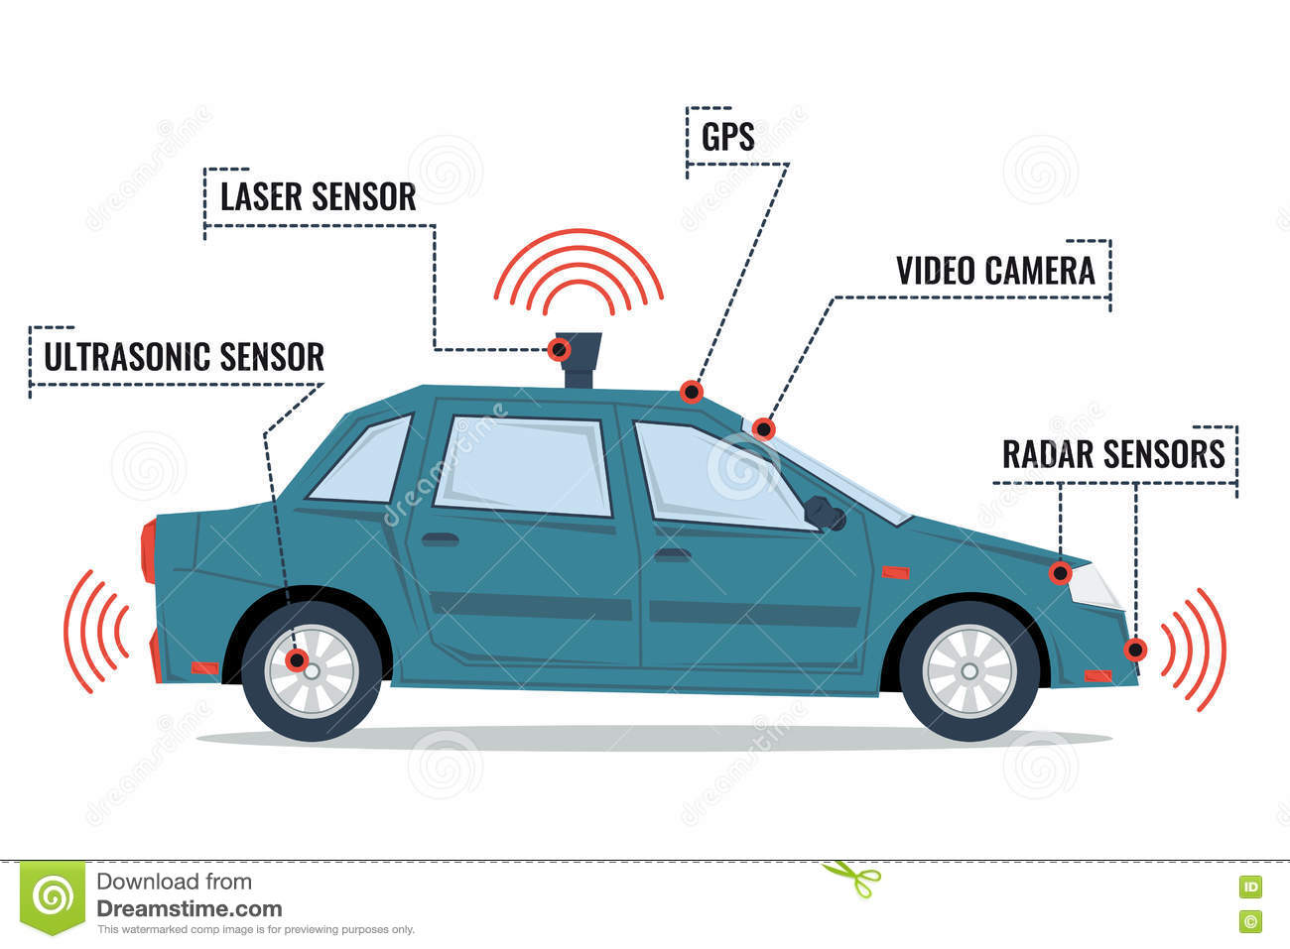
LIDAR
Wheel encoder

Slide 27
Autonomous vehicle
LIDAR

Slide 28
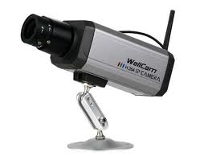
Data Format
Cellint_Time | Section_Id | Section_Label | Cellint_Speed | Sensor_Time | Sensor_Speed | Sensor_id
5:05:00 AM | 75 | ZN32 | 93.909657 | 5:01:00 AM | 104 | DTSACN11000M
5:07:00 AM | 75 | ZN32 | 90.257682 | 5:06:00 AM | 100 | DTSACN11000M
5:10:00 AM | 75 | ZN32 | 98.651968 | 5:06:00 AM | 100 | DTSACN11000M
5:12:00 AM | 75 | ZN32 | 94.801961 | 5:11:00 AM | 103 | DTSACN11000M
5:15:00 AM | 75 | ZN32 | 94.746822 | 5:11:00 AM | 103 | DTSACN11000M
5:17:00 AM | 75 | ZN32 | 93.781246 | 5:16:00 AM | 103 | DTSACN11000M
5:20:00 AM | 75 | ZN32 | 95.165659 | 5:16:00 AM | 103 | DTSACN11000M
5:22:00 AM | 75 | ZN32 | 91.205458 | 5:21:00 AM | 101 | DTSACN11000M
5:25:00 AM | 75 | ZN32 | 93.964128 | 5:21:00 AM | 101 | DTSACN11000M
Date/Time | 30/12/2007 01:01:01
Element | DRL01E04085M1
CONTAINMENT | 33
Distance_Media_M | 75
Type_Veh_1
speed | 97
state | OK\not received
interval | 5
Occupation | 5

Slide 29
GNSS Receiver
Index | UTC | Lon | Lat | SoG | Speed | CoG
1146 | 08:09:41.000 09/22/2016 | -1.56222 | 47.16262 | 23.63 | 23.64 | 112.72
1147 | 08:09:42.000 09/22/2016 | -1.56193 | 47.16254 | 23.65 | 23.67 | 112.45
1148 | 08:09:43.000 09/22/2016 | -1.56164 | 47.16246 | 23.68 | 23.7 | 112.26
1149 | 08:09:44.000 09/22/2016 | -1.56135 | 47.16238 | 23.72 | 23.74 | 111.79
1150 | 08:09:45.000 09/22/2016 | -1.56106 | 47.1623 | 23.79 | 23.8 | 111.54
KML
<?xml version='1.0' encoding='UTF-8'?><kml xmlns='http://www.opengis.net/kml/2.2‘ xmlns:gx='http://www.google.com/kml/ext/2.2'><Document><Placemark><open>1</open>
<gx:Track><altitudeMode>clampToGround</altitudeMode>
<when>2017-01-31T20:04:40Z</when> <gx:coord>35.152591699999995 32.913915599999996 0</gx:coord> <when>2017-01-31T20:02:07Z</when><gx:coord>35.152591699999995 32.913915599999996 0</gx:coord> <when>2017-01-31T19:59:30Z</when><gx:coord>35.152591699999995 32.913915599999996 0</gx:coord>
<when>2017-01-31T19:58:30Z</when><gx:coord>35.152591699999995 32.913915599999996 0</gx:coord> <when>2017-01-31T19:56:27Z</when><gx:coord>35.152591699999995 32.913915599999996 0</gx:coord> <when>2017-01-31T19:54:17Z</when><gx:coord>35.152591699999995 32.913915599999996 0</gx:coord> <when>2017-01-31T19:52:12Z</when><gx:coord>35.152591699999995 32.913915599999996 0</gx:coord>

Slide 30
According to Intel CEO
Brian Krzanich.
Vehicle will generate and consume roughly 40 terabytes of data for every eight hours of driving
Volume

Slide 31
Input data
structured Data
Im Allgemeinen wird zwischen zwei Datenstrukturen unterschieden, strukturierte und unstrukturierte Daten.
Unter strukturierten Daten versteht man Informationen, die meist in tabellarischer Form dargestellt werden können, wie es zum Beispiel in einer Liste von Merkmalen (Gewicht, Farbe, Alter, Maximale Geschwindigkeit) verschiedener Autoklassen der Fall ist.
Index | UTC | Lon | Lat | SoG | Speed
1146 | 08:09:41.000 09/22/2016 | -1.56222 | 47.16262 | 23.63 | 23.64
1147 | 08:09:42.000 09/22/2016 | -1.56193 | 47.16254 | 23.65 | 23.67
1148 | 08:09:43.000 09/22/2016 | -1.56164 | 47.16246 | 23.68 | 23.7
1149 | 08:09:44.000 09/22/2016 | -1.56135 | 47.16238 | 23.72 | 23.74
1150 | 08:09:45.000 09/22/2016 | -1.56106 | 47.1623 | 23.79 | 23.8

Slide 32
Input data
Unstructured data
Unstrukturierte Daten sind hingegen Video-, Bild-, Audio- oder Text-Daten und können nicht in der Form einer Tabelle dargestellt werden. Der Begriff unstrukturiert bezieht sich auf die Struktur der Informationen die durch das Datenformat innerhalb eines Daten-files gegeben.
$GNRMC,075035.00,A,4709.38620,N,00138.24936,W,0.004,,220916,,,D*72 $GNVTG,,T,,M,0.004,N,0.008,K,D*34 $GNGNS,075035.00,4709.38620,N,00138.24936,W,DA,18,0.63,30.1,48.1,,0000*4D $GNGGA,075035.00,4709.38620,N,00138.24936,W,2,12,0.63,30.1,M,48.1,M,,0000*6B $GNGSA,A,3,21,23,25,05,26,27,29,31,16,20,,,1.06,0.63,0.85*1E $GNGSA,A,3,80,79,81,83,65,66,73,82,,,,,1.06,0.63,0.85*1A $GPGSV,4,1,13,05,11,045,36,09,04,331,36,16,33,301,44,18,02,144,*79 $GPGSV,4,2,13,20,18,097,40,21,62,138,48,23,07,303,30,25,20,118,36*70 $GPGSV,4,3,13,26,64,304,49,27,13,254,43,29,39,061,47,31,47,209,50*79 $GNGRS,075035.00,1,-1.5,-2.3,8.3,-13.6,-5.0,2.8,2.6,-0.7,-3.8,0.1,,*68 $GNGRS,075035.00,1,-6.3,14.8,-2.6,1.1,-6.3,8.8,-12.1,1.7,,,,*59 $GNGST,075035.00,28,,,,0.58,0.44,1.0*4B $GNGBS,075035.00,0.6,0.4,1.0,73,,12.1,6.1*69 $PUBX,00,075035.00,4709.38620,N,00138.24936,W,78.277,D3,0.73,1.0,0.008,269.62,-0.002,,0.63,0.85,0.50,18,0,0*62

Slide 33
Data Anomalies
Incomplete data
Missing data
  For instance : GNSS

Slide 34
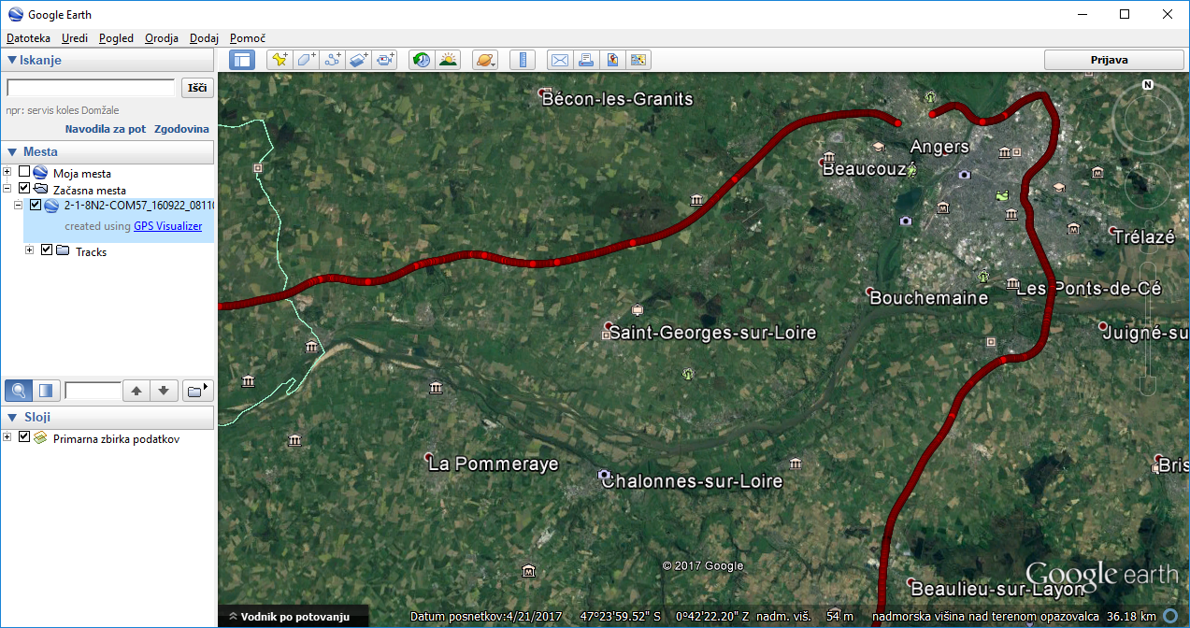
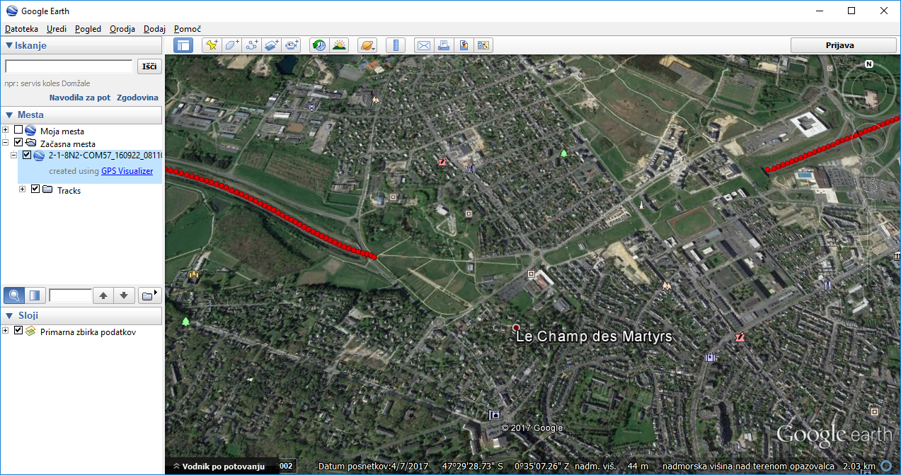
Error sources

Slide 35
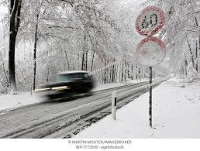
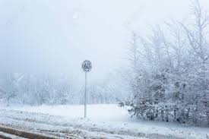
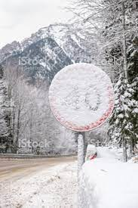
Missing/ Incomplete data
Based historical data: traffic sign position
Based Real-time ???
Invisibility/accident/road work:
Message (60)

Slide 36
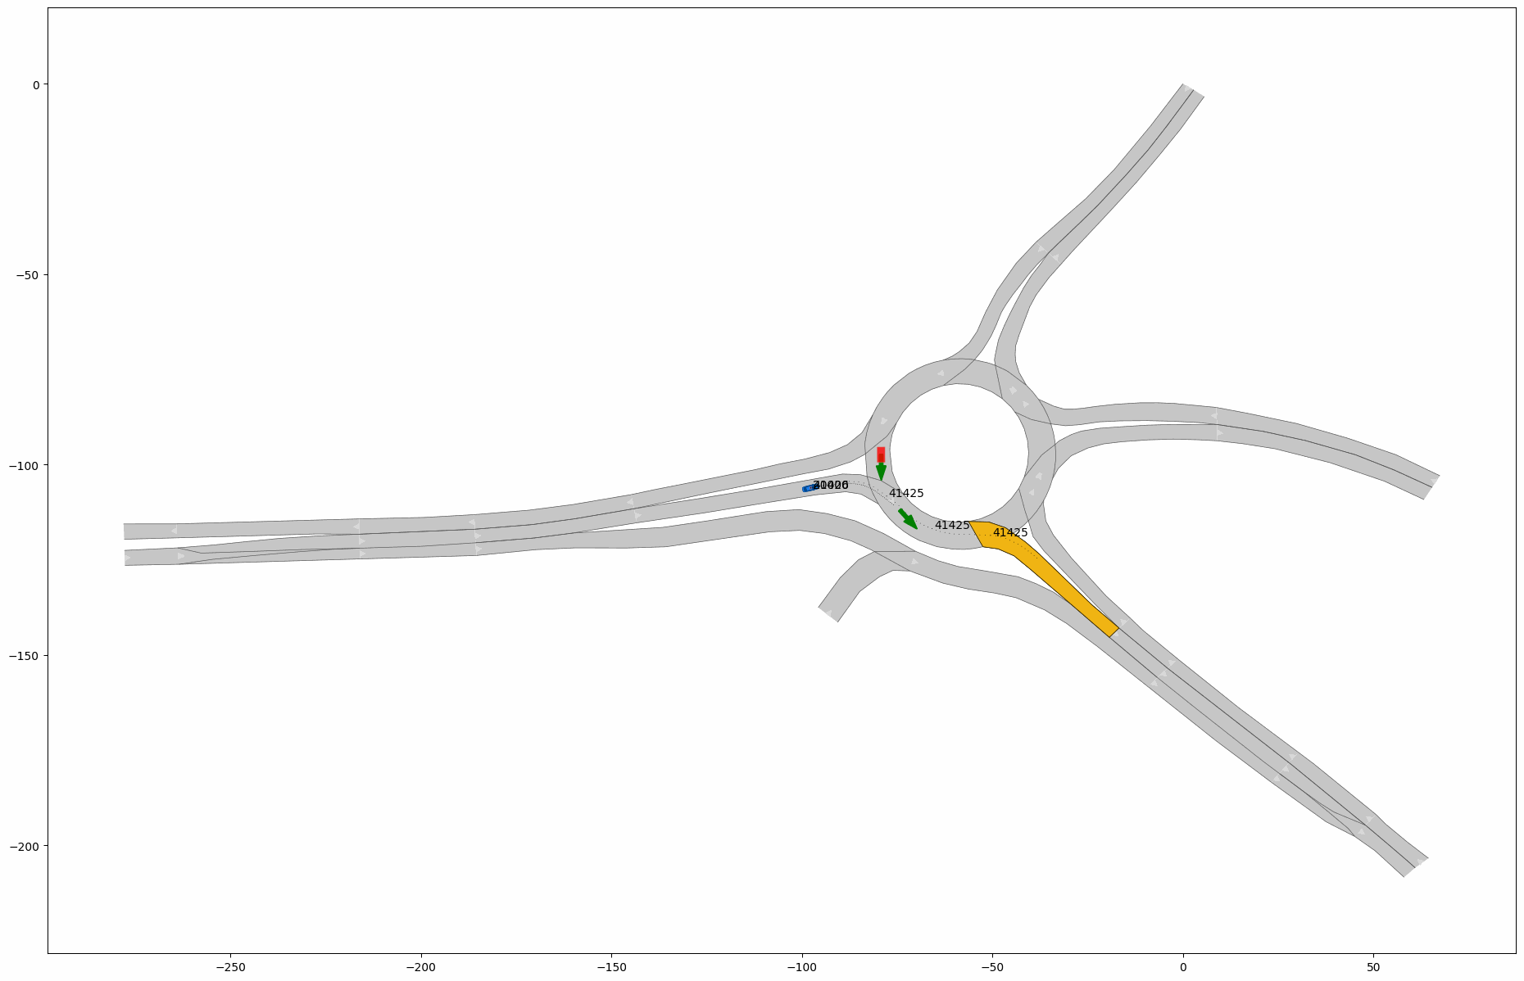
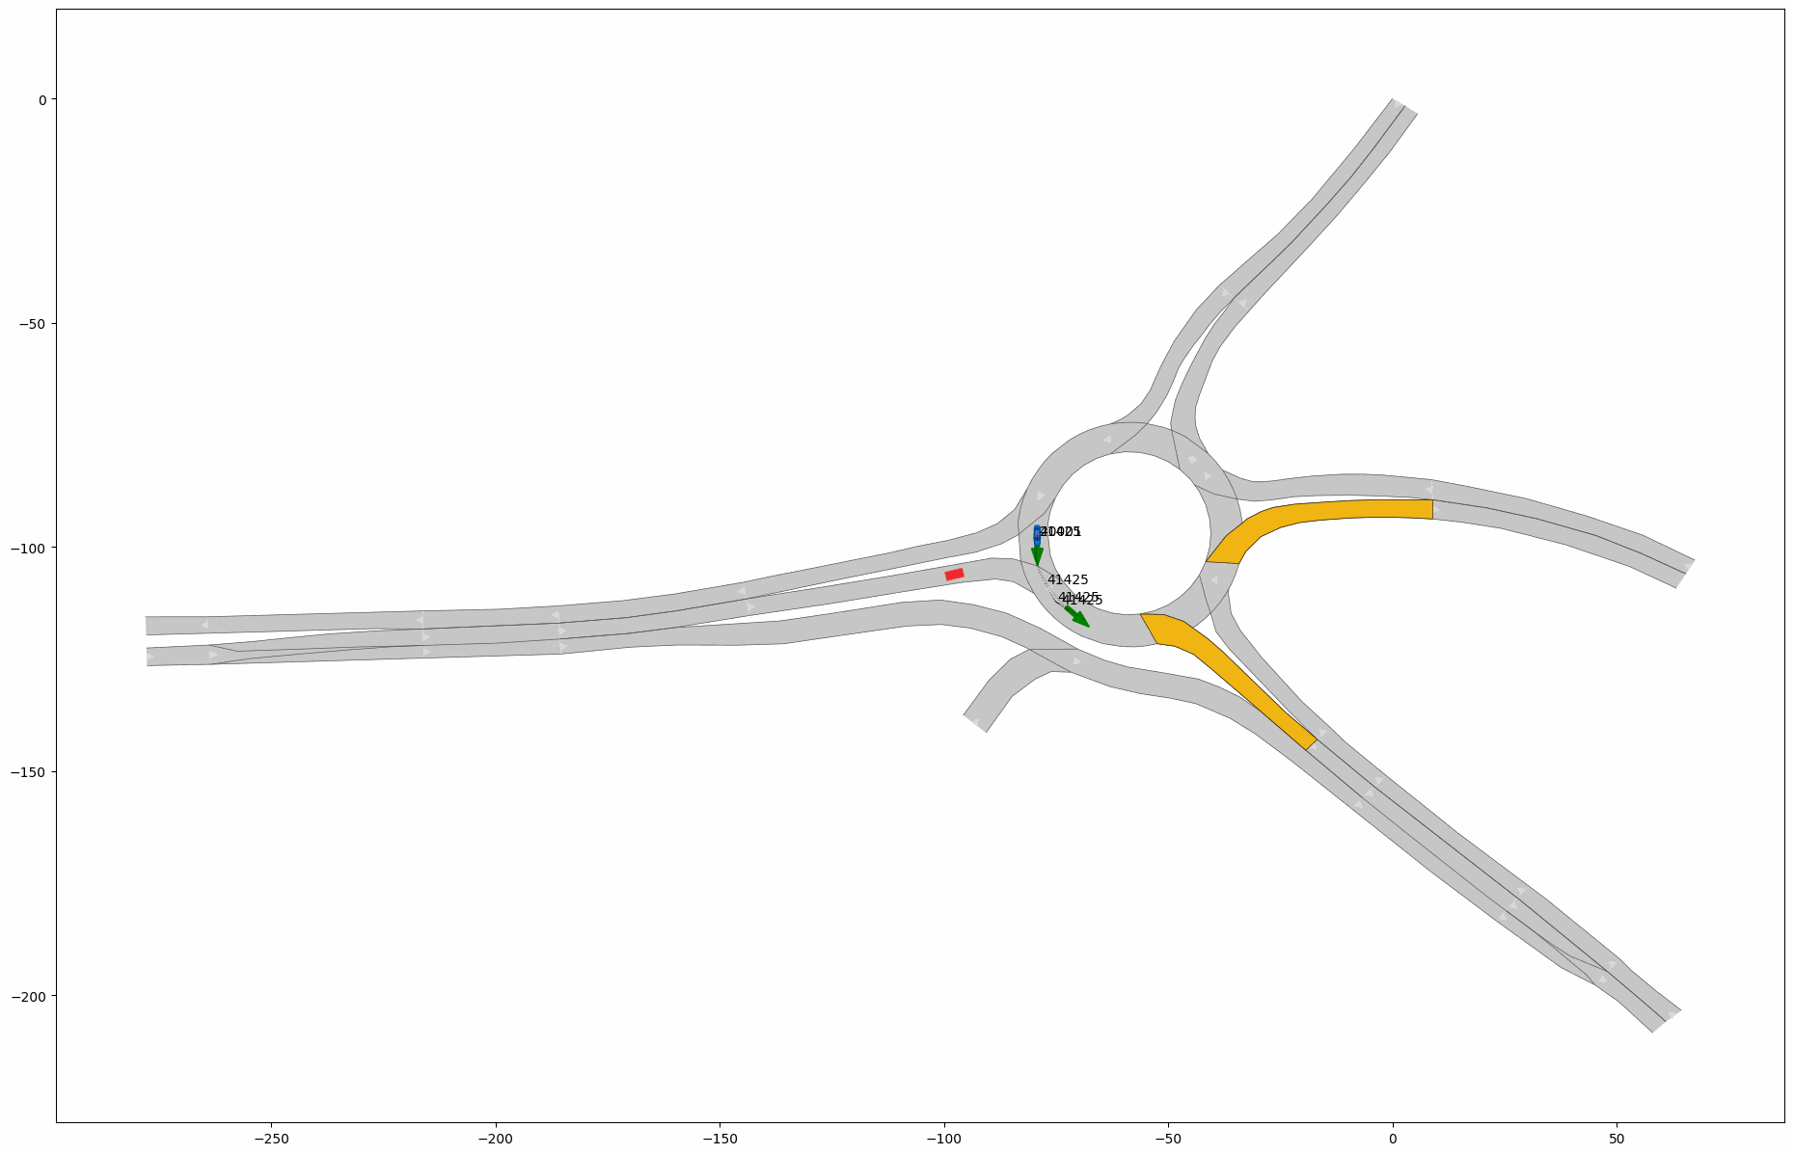
accident avoidance

Slide 37
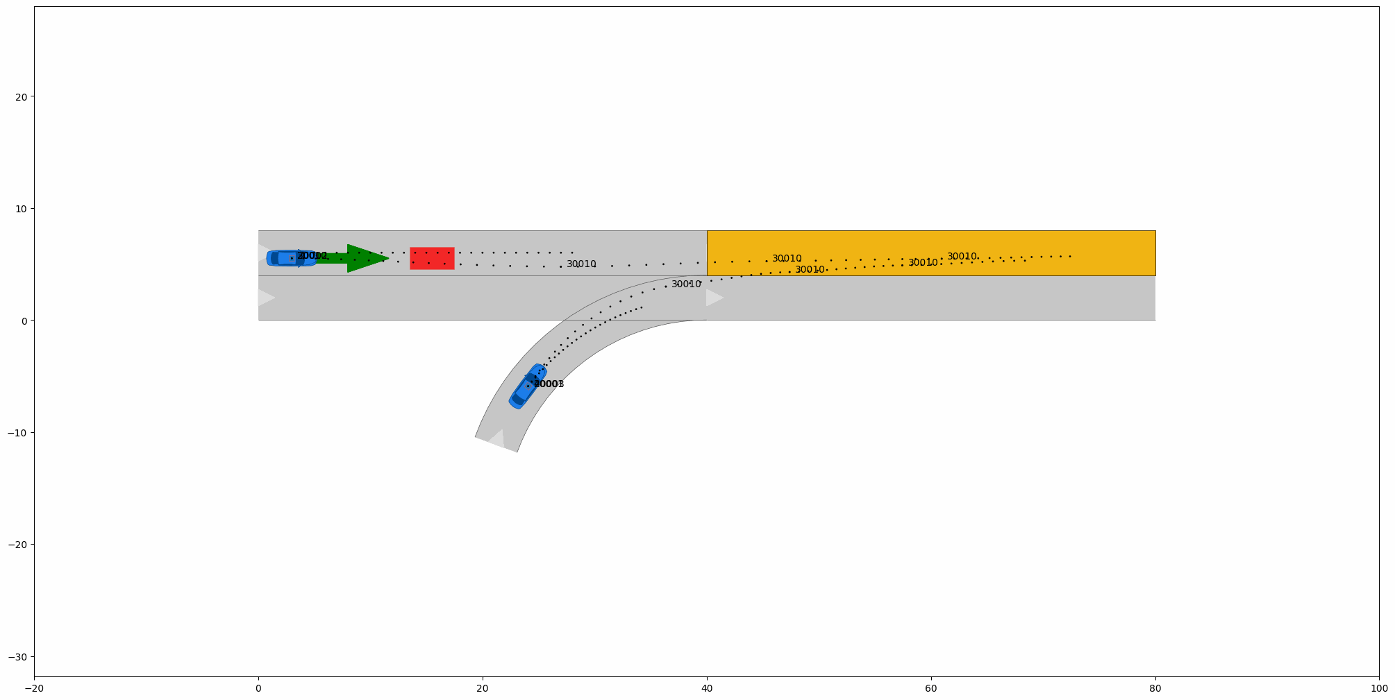
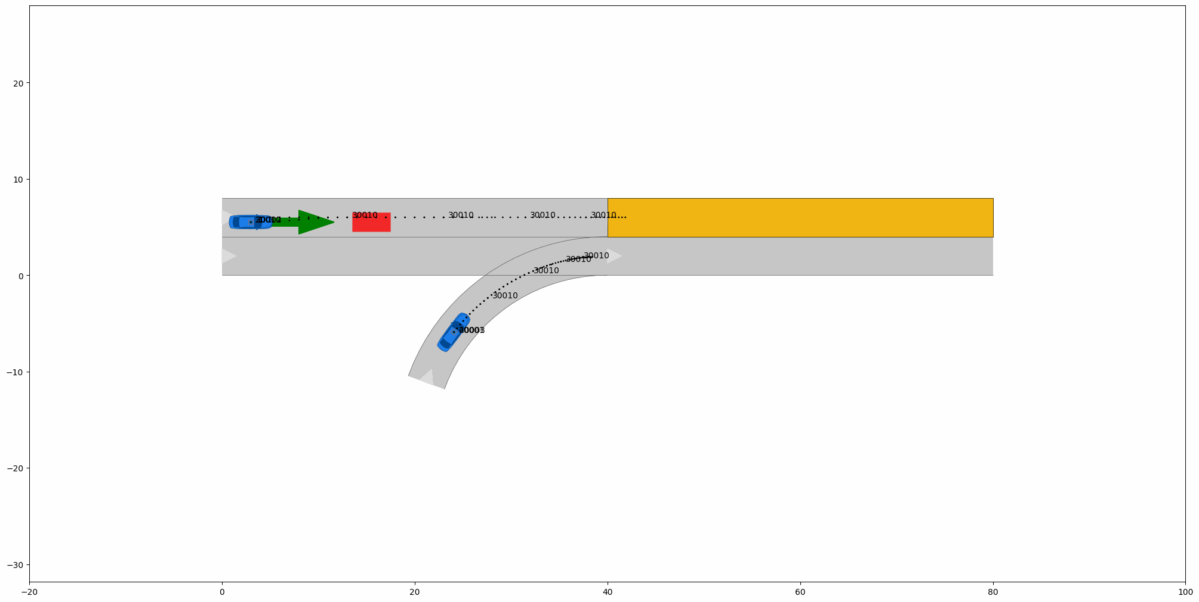
Anomalies daten
accident avoidance

Slide 38
Order of magnitude of the errors on the position from the main error sources
Atmosphere
Source of error | Resulting position error
Satellites’ clock and orbits | 0.5m – 1m
Atmospheric delays | 1m – 3m
Multipath and non-line-of-sight (NLOS) signals | 0.1m – 100m
Receiver thermal noise | 0.1m

Slide 39
Cyber attack levels
Data falsification

Slide 40
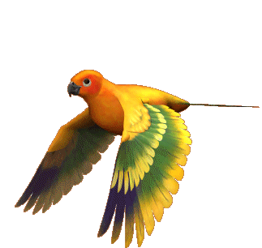
AI Reasoning
Consider an example that can’t be handled by monotonic logic
  Birds can fly
Seems logical, right?

Slide 41
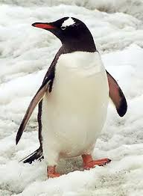
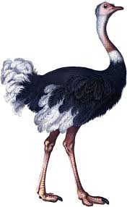
Exceptions?
What about exceptions?
  Ostrich, Penguins

Slide 42
Exceptions
Bird(x) → Flies(x)
How to handle exceptions?
  Bird(x) ∧ ¬ Abnormal(x) → Flies(x)
Through non-monotonic logic, we handle exceptions

Slide 43
Handling Exceptions
We know
  Ostrich(x) → Abnormal(x)
  Ostrich is not a normal bird
  We conclude
    Ostrich(x) → Bird(x) ∧ ¬Flies(x)
We make all exceptions this way

Slide 44
Specifying Defaults
Monotonic logic has formal systems to handle defaults
  Defaults: Known facts and rules
Non-monotonic logic uses incomplete and uncertain information to form patterns for decision making
  Abduction: Interpretation of the rules and facts.

Slide 45
Reasoning
Default logic
  The predicate logic used as set of inferences
Modal Operator - consistent with known facts
  ∀x,y: A(x,y) ∧ B(x,y)
  ⇒ C (x,y)
  Here B(x,y) is the Modal Operator
Notes:
Here, we can know that A is true and we can assume that B is consistent as well, to prove that C is true

Slide 46
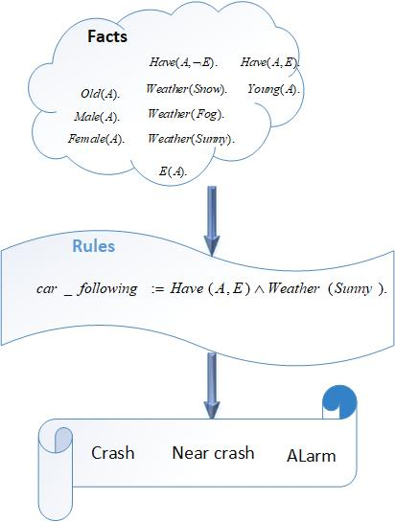
Prolog

Slide 47
Approaches used in Computation Intelligence
  Machine Learning Schemes:
      Linear Regression,
      convolutional neural networks and

Slide 48
Linear Regression
Next Lecture:

Slide 49
AI, ML
Artificial Intelligence
Machine Learning
Deep learning
CNN

Slide 50
Data Science Life Cycle
Sensors
IoT Devices
Statistical measurements
Data training
Test Data

Slide 51
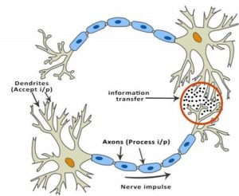
Künstliche Neuronal Netze (KNN)
Convolutional Neural Network (CNN)
Biological neural networks inspired the development of artificial neural networks. However, CNNs are not even an approximate representation of how the brain works. It is still useful to understand the relevance of an activation function in a biological neural network before we know why we use it in an artificial neural network.
A typical neuron has a physical structure that consists of a cell body, an axon that sends messages to other neurons, and dendrites that receives signals or information from other neurons.

Slide 52
In the above picture, the red circle indicates the region where the two neurons communicate. The neuron receives signals from other neurons through the dendrites. The weight (strength) associated with a dendrite, called synaptic weights, gets multiplied by the incoming signal. The signals from the dendrites are accumulated in the cell body, and if the strength of the resulting signal is above a certain threshold, the neuron passes the message to the axon. Otherwise, the neuron kills the signal and is not propagated further.
The activation function makes the decision of whether or not to pass the signal. In this case, it is a simple step function with a single parameter – the threshold. Now, when we learn something new ( or unlearn something ), the threshold and the synaptic weights of some neurons change. This creates new connections among neurons making the brain learn new things.

Slide 53
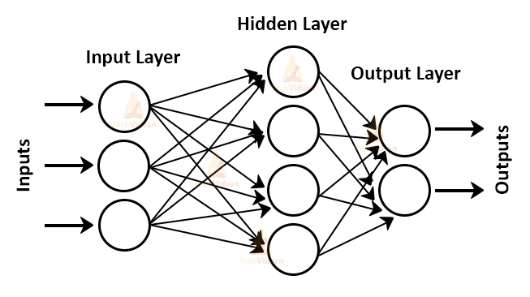
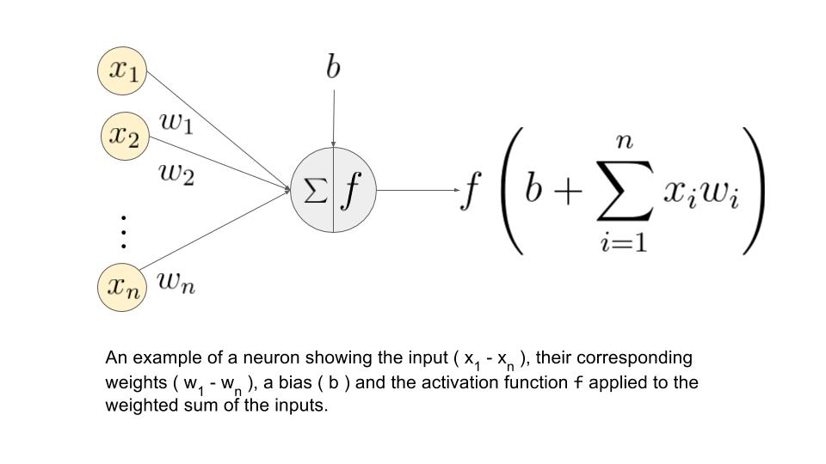
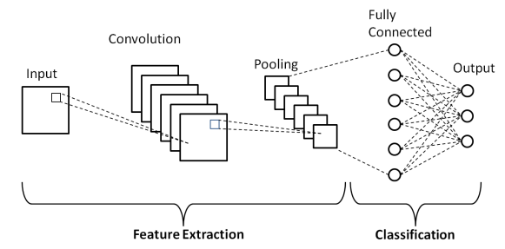
Infrastructure of CNN

Slide 54
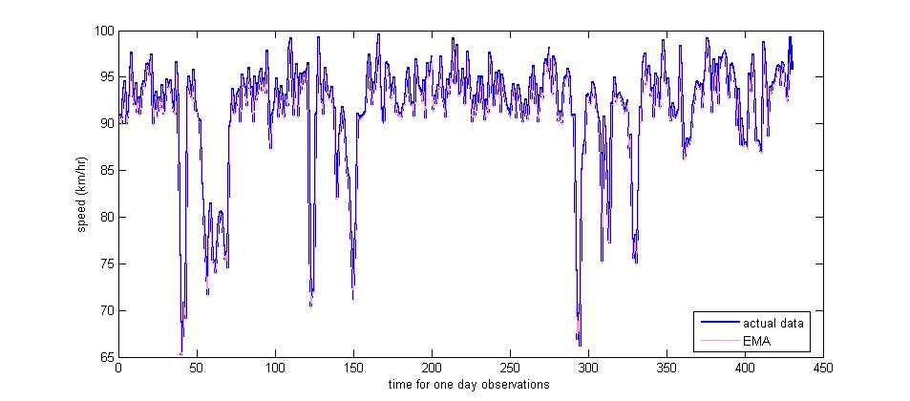
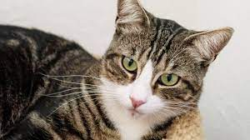
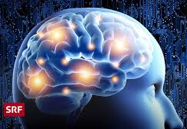
1D /2D/3D NN
In 1D CNN bewegt sich der Kernel in eine Richtung. Eingabe- und Ausgabedaten von 1D CNN sind zweidimensional. Wird hauptsächlich für Zeitreihendaten verwendet.
Bei 2D-CNN bewegt sich der Kernel in zwei Richtungen. Ein- und Ausgabedaten von 2D-CNN sind dreidimensional. Wird hauptsächlich für Bilddaten
Bei 3D-CNN bewegt sich der Kernel in 3 Richtungen. Eingabe- und Ausgabedaten von 3D-CNN sind vierdimensional. Wird hauptsächlich für 3D-Bilddaten (MRT, CT-Scans, Video) verwendet.

Slide 55
Funktionsweise
Wenn beispielsweise ein Bild mit N X N Pixeln als Eingabe übergeben wird, wird jedes Pixel als Eingabe jedem Neuron der ersten Schicht zugeführt.
Neuronen einer Schicht sind durch „Kanäle“ mit den folgenden Schichten verbunden.
Jedem dieser Kanäle ist ein numerischer Wert namens „Gewicht“ zugeordnet.
Die Eingaben (x1, x2, …… xn) werden mit ihren entsprechenden Gewichten multipliziert und ihre Summe wird an die Neuronen in der verborgenen Schicht gesendet.
Jedem dieser Neuronen ist ein numerischer Wert namens „Bias“ zugeordnet, der weiter zur Eingangssumme hinzugefügt wird.
Dieser Wert wird dann durch eine Schwellenwertfunktion namens „Aktivierungsfunktion“ geleitet, die bestimmt, ob das jeweilige Neuron aktiviert wird oder nicht.
Das aktivierte Neuron überträgt Daten über Kanäle an Neuronen der nächsten Schicht.
Somit werden Daten durch das Netzwerk propagiert und das Neuron mit dem höchsten Wert bestimmt die Ausgabe.

Slide 56
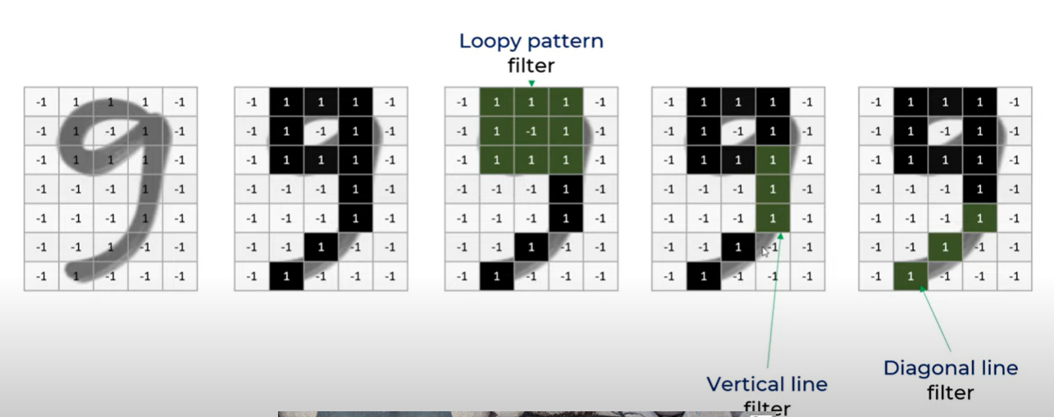
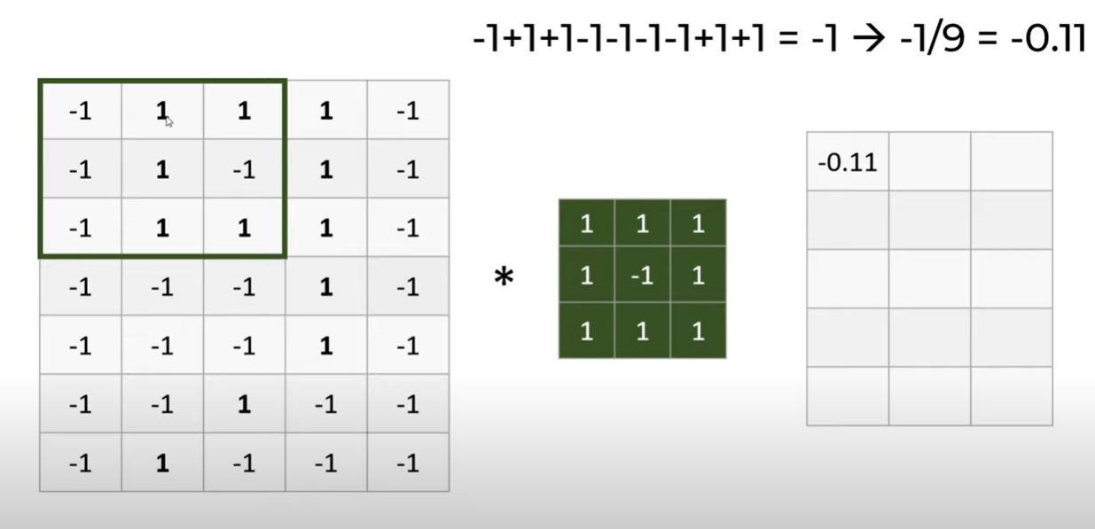

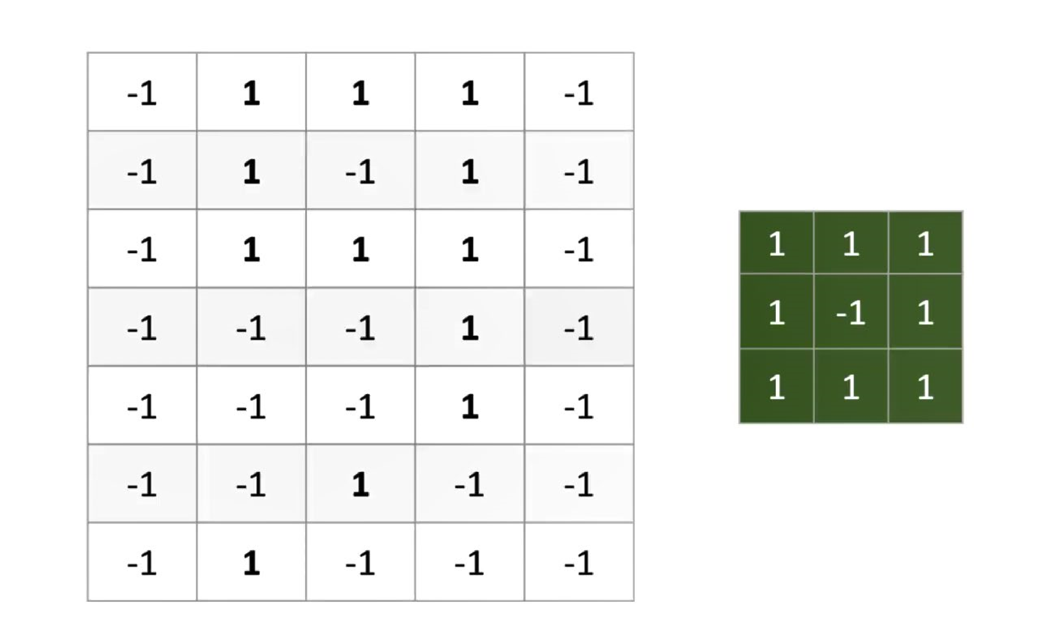
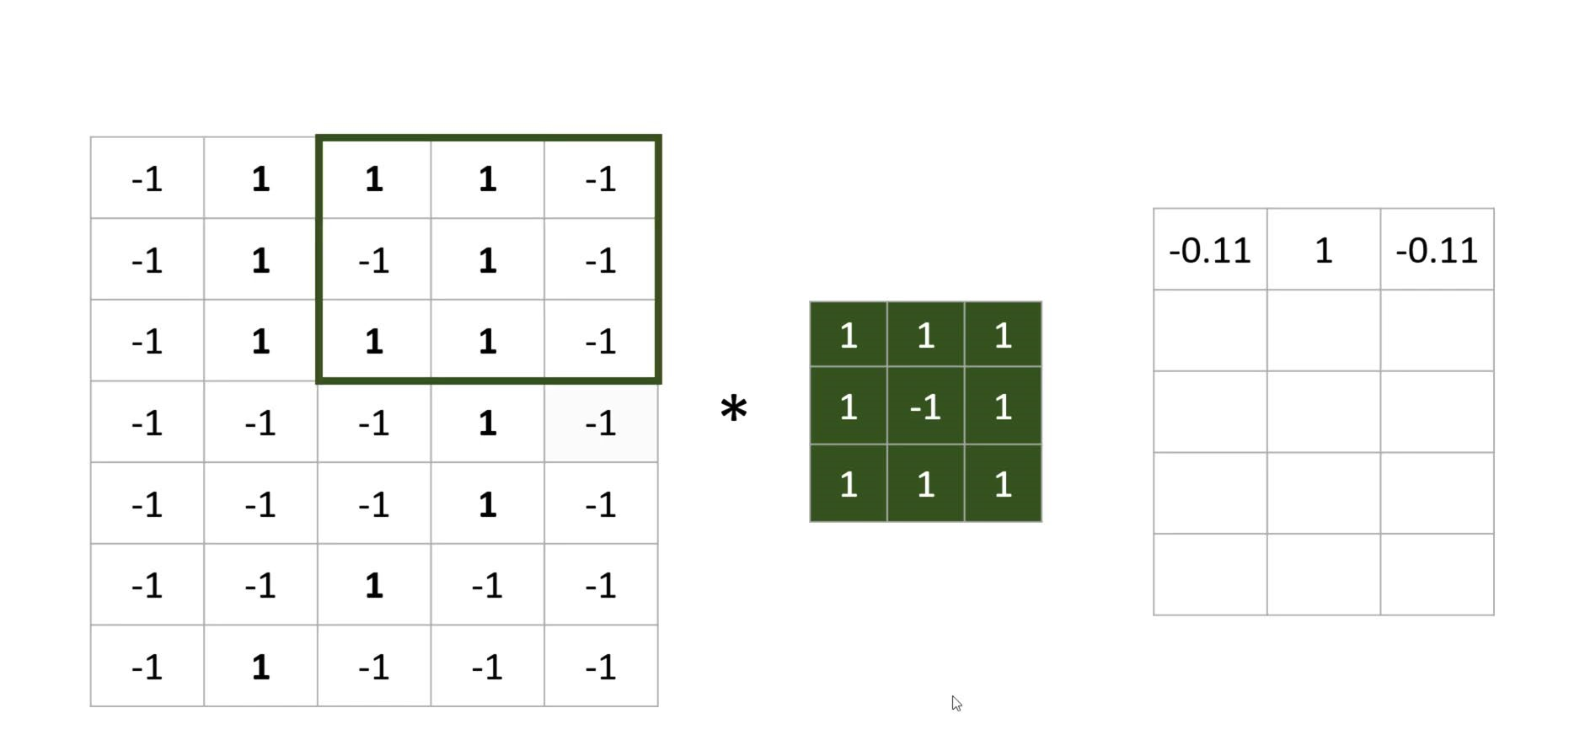
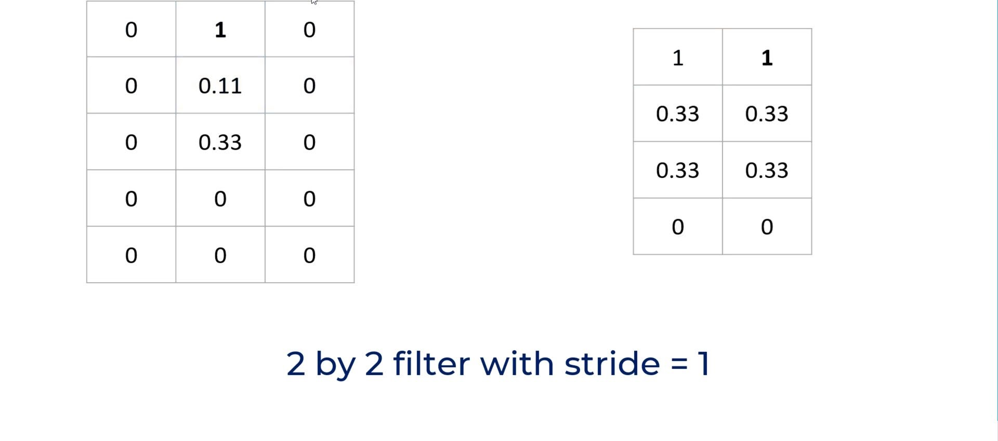
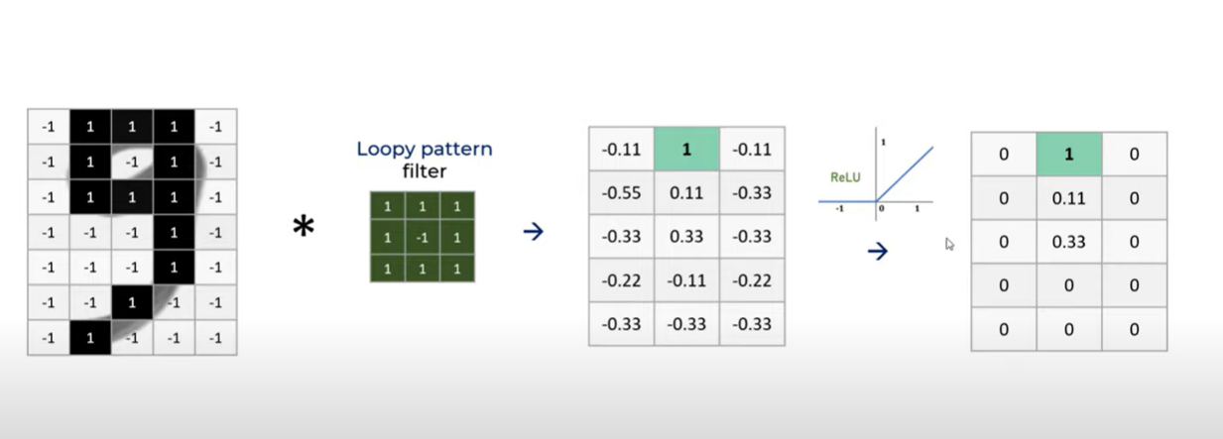


Slide 57
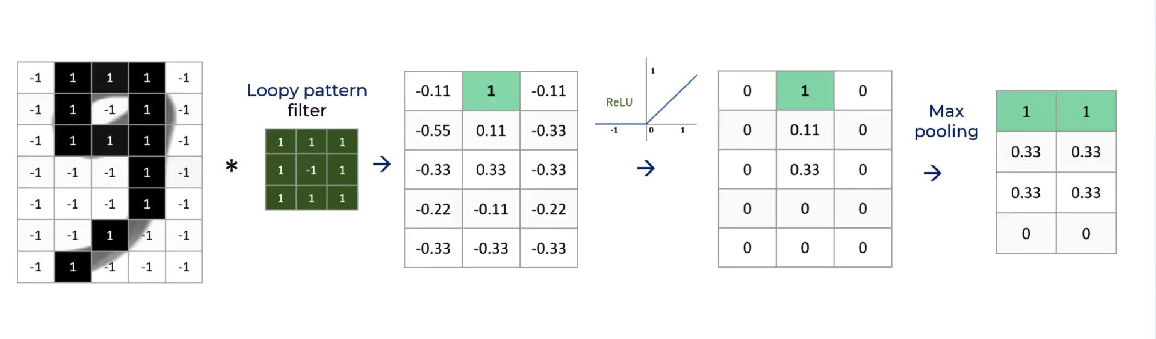
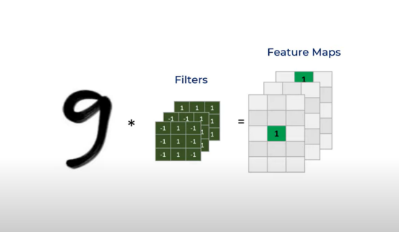

Slide 58
Implementing of CNN in Python
TensorFlow
pytorch

Slide 59
Application of AI
Autonomous vehicle
Surveillance
Agriculture
Medicine
Finance

Slide 60
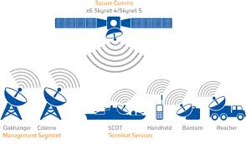
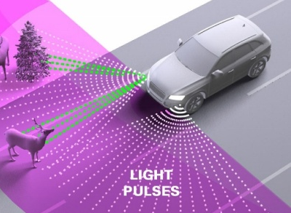
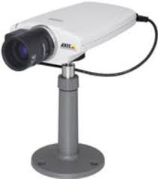

GPS\GNSS
LiDAR
Wireless Networks
Digital Camera
Big data management
Belong
Not Belong

Slide 61

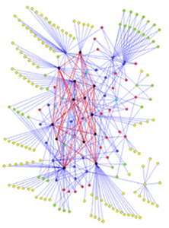

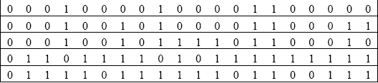
Forecast Scheme Based Real-Time Information
Real-time data
Forecasting
KNN
Historical data
Free
Free
Free
Busy
Historical database is a collection past travel observations of the system

Slide 62
Current Research

Slide 63
Making Decision

Slide 64
Agriculture

Slide 65
Marine Detection

Slide 66



Smart Mapping and Pasture Land Management
Nr
Location
Type
Feature Extraction
Milk
CNN
distance
Eating time
Rest time
Smart Farming

Slide 67

Resource Allocation strategy based on CR
BTS
MS-1

Slide 68



Slide 69
References
https://www.guru99.com/convnet-tensorflow-image-classification.html#1
https://learnopencv.com/understanding-activation-functions-in-deep-learning/

Slide 70
Thanks for your Attention
Q & A

