Slide 1
English III
Prof. Dr. Sylvana Krauße

Slide 2

Week 8
Presentations:
- 10-12 min + 3-5 min interaction with audience (quizz, questions, discussion, etc.)
talk about a technical topic that is somehow related to your course of study
be selective > you decide what you want to talk about

Slide 3
Week 8
What do you think are my marking criteria for your final presentation?

Slide 4
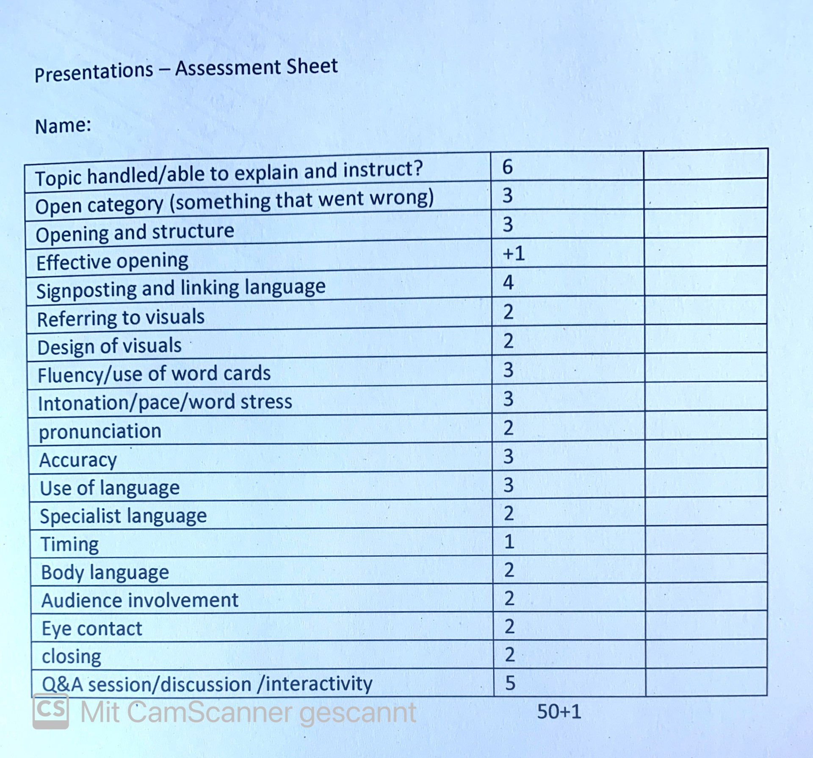
Week 8
My marking scheme:

Slide 5
Week 8
pronunciation > new and complex words should be checked on leo.org or forwo.com
say them out loud!
keywords or short key phrases, no complete sentences!
use the spell check
speak as freely as possible!
with or without wordcards!

Slide 6
Week 8
use natural, spoken language
feel uncomfortable with your language > change it!
presentation language (signposting, rhetorical questions)
And now to …
speak slowly > avoid monotone voice
Don’t memorise your talk!

Slide 7
Week 8
Get your grammar right!
passive voice
mix-up of adjectives and adverbs
word order
prepositions
3rd person s

Slide 8
Week 8
When something goes wrong > stay calm
no swear words
no sounds
Don’t apologise!
take things seriously
be professional
show enthusiasm

Slide 9
Week 8
structure your presentation
be logical and coherent
well-designed visuals > short information, no overload
vary your voice
project your voice
allow for pauses

Slide 10
Week 8
learn to control your nervousness
prepare extremely well
stage fright is normal and positive
avoid nervous gestures and mannerisms
good body language
facial expressions > look friendly

Slide 11
Week 8
keep eye contact
speak to the entire audience
respect the time limit
take time for interaction with audience

Slide 12
Week 8
avoid fillers?

Slide 13
Week 8
Yes and no!

Slide 14
Week 8
Yes and no!
https://ed.ted.com/lessons/why-do-we-like-hesitate-when-we-um-speak-lorenzo-garcia-amaya
Watch the video and take (mental) notes of the ideas brought forward in this video clip.
Discuss these ideas in your breakout room. What do you think about it? Does it make sense to you? Has it changed your view on this topic?

