Slide 1
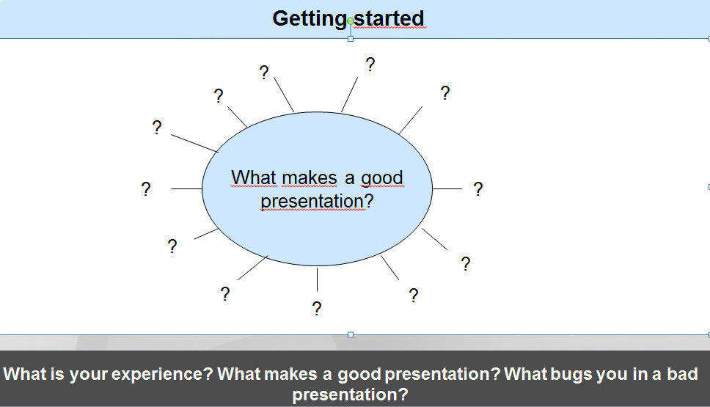


English III

Slide 2
English III
What makes a good presentation?
  clear structure
  speak fluently
  speak clearly
  good body language
  keep eye contact
  audience involvement
  good visuals
  good preparation
  make it interesting and relevant
  intonation
  pronunciation
  be able to say it in simple words
  easy to follow
  no funny gestures
  use of pauses
  …
  …

Slide 3
English III
What makes a good presentation?
  clear structure
  speak fluently
  speak clearly
  good body language
  keep eye contact
  audience involvement
  good visuals
  good preparation
  make it interesting and relevant
  intonation
  pronunciation
  be able to say it in simple words
  easy to follow
  no funny gestures
  use of pauses
  …
  …

Slide 4
English III
What makes a good presentation?
  clear structure
  speak fluently
  speak clearly
  good body language
  keep eye contact
  audience involvement
  good visuals
  good preparation
  make it interesting and relevant
  intonation
  pronunciation
  be able to say it in simple words
  easy to follow
  no funny gestures
  use of pauses
  …
  …

Slide 5
English III
What makes a good presentation?
  clear structure
  speak fluently
  speak clearly
  good body language
  keep eye contact
  audience involvement
  good visuals
  good preparation
  make it interesting and relevant
  intonation
  pronunciation
  be able to say it in simple words
  easy to follow
  no funny gestures
  use of pauses
  …
  …

Slide 6
English III
What makes a good presentation?
  clear structure
  speak fluently
  speak clearly
  good body language
  keep eye contact
  audience involvement
  good visuals
  good preparation
  make it interesting and relevant
  intonation
  pronunciation
  be able to say it in simple words
  easy to follow
  no funny gestures
  use of pauses
  …
  …

Slide 7
English III
What makes a good presentation?
  clear structure
  speak fluently
  speak clearly
  good body language
  keep eye contact
  audience involvement
  good visuals
  good preparation
  make it interesting and relevant
  intonation
  pronunciation
  be able to say it in simple words
  easy to follow
  no funny gestures
  use of pauses
  …
  …

Slide 8
English III
What makes a good presentation?
  clear structure
  speak fluently
  speak clearly
  good body language
  keep eye contact
  audience involvement
  good visuals
  good preparation
  make it interesting and relevant
  intonation
  pronunciation
  be able to say it in simple words
  easy to follow
  no funny gestures
  use of pauses
  …
  …

Slide 9
English III
What makes a good presentation?
  clear structure
  speak fluently
  speak clearly
  good body language
  keep eye contact
  audience involvement
  good visuals
  good preparation
  make it interesting and relevant
  intonation
  pronunciation
  be able to say it in simple words
  easy to follow
  no funny gestures
  use of pauses
  …
  …

Slide 10
English III
What makes a good presentation?
  clear structure
  speak fluently
  speak clearly
  good body language
  keep eye contact
  audience involvement
  good visuals
  good preparation
  make it interesting and relevant
  intonation
  pronunciation
  be able to say it in simple words
  easy to follow
  no funny gestures
  use of pauses
  …
  …

Slide 11
English III
What makes a good presentation?
  clear structure
  speak fluently
  speak clearly
  good body language
  keep eye contact
  audience involvement
  good visuals
  good preparation
  make it interesting and relevant
  intonation
  pronunciation
  be able to say it in simple words
  easy to follow
  no funny gestures
  use of pauses
  …
  …

Slide 12
English III
What makes a good presentation?
  clear structure
  speak fluently
  speak clearly
  good body language
  keep eye contact
  audience involvement
  good visuals
  good preparation
  make it interesting and relevant
  intonation
  pronunciation
  be able to say it in simple words
  easy to follow
  no funny gestures
  use of pauses
  …
  …

Slide 13
English III
What makes a good presentation?
  clear structure
  speak fluently
  speak clearly
  good body language
  keep eye contact
  audience involvement
  good visuals
  good preparation
  make it interesting and relevant
  intonation
  pronunciation
  be able to say it in simple words
  easy to follow
  no funny gestures
  use of pauses
  …
  …

Slide 14
English III
What makes a good presentation?
  clear structure
  speak fluently
  speak clearly
  good body language
  keep eye contact
  audience involvement
  good visuals
  good preparation
  make it interesting and relevant
  intonation
  pronunciation
  be able to say it in simple words
  easy to follow
  no funny gestures
  use of pauses
  …
  …

Slide 15
English III
What makes a good presentation?
  clear structure
  speak fluently
  speak clearly
  good body language
  keep eye contact
  audience involvement
  good visuals
  good preparation
  make it interesting and relevant
  intonation
  pronunciation
  be able to say it in simple words
  easy to follow
  no funny gestures
  use of pauses
  …
  …

Slide 16
English III
What makes a good presentation?
  clear structure
  speak fluently
  speak clearly
  good body language
  keep eye contact
  audience involvement
  good visuals
  good preparation
  make it interesting and relevant
  intonation
  pronunciation
  be able to say it in simple words
  easy to follow
  no funny gestures
  use of pauses
  …
  …

Slide 17
English III
Course content
  - opening and closing
  - clear structure and signposting
  - visual aids
  - non-verbal communication
  - presenting facts and figures
  - question and answer session

Slide 18
English III
Course content
always in a technical context
  - opening and closing
  - clear structure and signposting
  - visual aids
  - non-verbal communication
  - presenting facts and figures
  - question and answer session

Slide 19
English III
Course content
always in a technical context
  - opening and closing
  - clear structure and signposting
  - visual aids
  - non-verbal communication
  - presenting facts and figures
  - question and answer session
language
strategies
practice!!!

Slide 20
English III
Course content
always in a technical context
  - opening and closing
  - clear structure and signposting
  - visual aids
  - non-verbal communication
  - presenting facts and figures
  - question and answer session
language
strategies
practice!!!
You are an expert in presentations! Put it into practice!

Slide 21
English III
Good presentation skills = combination of personal and professional skills!
Course content
always in a technical context
  - opening and closing
  - clear structure and signposting
  - visual aids
  - non-verbal communication
  - presenting facts and figures
  - question and answer session
language
strategies
practice!!!
You are an expert in presentations! Put it into practice!

Slide 22

English III
The ugly truth is …
  there are born presenters and
        ……. the others
        … all eyes are on you
        … all ears are focused on what you say

Slide 23

English III
The good news is …
  .... there‘s something you can do!
  …. prepare extremely well for your presentation!

